Slide 1
New Jersey Center for Teaching and Learning
Progressive Mathematics Initiative
This material is made freely available at www.njctl.org and is intended for the non-commercial use of students and teachers. These materials may not be used for any commercial purpose without the written permission of the owners. NJCTL maintains its website for the convenience of teachers who wish to make their work available to other teachers, participate in a virtual professional learning community, and/or provide access to course materials to parents, students and others.
Click to go to website:
www.njctl.org

Slide 2
6th Grade
Decimal Computation
2012-07-09
www.njctl.org

Slide 3
Setting the PowerPoint View
Use Normal View for the Interactive Elements
To use the interactive elements in this presentation, do not select the Slide Show view. Instead, select Normal view and follow these steps to set the view as large as possible:
On the View menu, select Normal.
Close the Slides tab on the left.
In the upper right corner next to the Help button, click the ^ to minimize the ribbon at the top of the screen.
On the View menu, confirm that Ruler is deselected.
On the View tab, click Fit to Window.
Use Slide Show View to Administer Assessment Items
To administer the numbered assessment items in this presentation, use the Slide Show view. (See Slide 14 for an example.)

Slide 4
Decimal Computation Unit Topics
Click on the topic to
go to that section
Long Division Review
Adding Decimals
Subtracting Decimals
Multiplying Decimals
Dividing Decimals
Real Life Applications
Common Core Standards: 6.NS.2, 6.NS.3

Slide 5
Long Division Review
Return to Table
of Contents

Slide 6
Some division terms to remember....
The number to be divided into is known as the dividend
The number which divides the other number is known as the divisor
The answer to a division problem is called the quotient
4 quotient
divisor 5 20 dividend
__
20
= 4
20 ÷ 5 = 4
5

Slide 7
When we are dividing, we are breaking apart into equal groups
EXAMPLE 1
Find 132
3
0
4
Step 1: Can 3 go into 1, no so can 3 go into 13, yes
4
3 132
Click for step 1
- 12
1
3 x 4 = 12
13 - 12 = 1
Compare 1 < 3
0
2
0
- 12
0
0
Step 2: Bring down the 2. Can 3 go into 12, yes
3 x 4 = 12
12 - 12 = 0
Compare 0 < 3
0
Click for step 2

Slide 8
Step 3: Check your answer.
44 x 3
Click to
Reveal
132

Slide 9
EXAMPLE 2
(change pages to see each step)
Find
Step 1: Can 15 go into 3, no so can 15 go into 35, yes
2
Click for step 1
15 357
-30
5
15 x 2 = 30
35 - 30 = 5
Compare 5 < 15

Slide 10
EXAMPLE 2
(change pages to see each step)
Find
2
3
Step 2: Bring down the 7. Can 25 go into 207, yes
15 357
-30
5
7
45
12
15 x 3 = 45
57 - 45 =12
Compare 12 < 15
-

Slide 11
EXAMPLE 2
(change pages to see each step)
Find
Step 3: You need to add a decimal and a zero since the division is not complete. Bring the zero down and continue the long division.
2
3
.8
15 357.0
-30
5
7
- 45
120
- 120
0
15 x 8 = 120
120 - 120 = 0
Compare 0 < 15

Slide 12
Step 4: Check your answer.
23.8
x 5
357
Click to
Reveal

Slide 13
Complete the following problems.
Discuss your answers with your group.
1. 2.
3. 4.
Click to
Reveal
Click to
Reveal
41
324
Click to
Reveal
Click to
Reveal
19.5
23.2

Slide 14
1
Compute.
Notes:
Answer: 28.2

Slide 15
2
Compute.
Notes:
Answer: 36.8

Slide 16
3
Compute.
Notes:
Answer: 45.25

Slide 17
4
Compute.
Notes:
Answer: 43

Slide 18
5
Compute.
Notes:
Answer: 53.5

Slide 19
Adding Decimals
Return to Table
of Contents

Slide 20
If you know how to add whole numbers then you can add decimals. Just follow these few steps.
Step 1:
Put the numbers in a vertical column, aligning the decimal points.
Step 2:
Add each column of digits, starting on the right and working to the left.
Step 3:
Place the decimal point in the answer directly below the decimal points that you lined up in Step 1.

Slide 21
When adding or subtracting decimals, always remember to align the decimals vertically...
0.25
0.25
0.25
0.25
1.00
+

Slide 22
Now, try this - Don't forget - LINE 'EM UP
0.1 + 1.25 + 0.04 + 1.39
x
0.10
1.25
0.04
1.39
You can add a zero
as a place holder to
help line your numbers up.
+
2.78

Slide 23
TRY THESE.
Complete in your notebook then check with the rest of your group.
To check your answer, click the box.
1) 8.23 + 4.125 + 0.1189 2) 3.178 + 12.28 + 9
8.23 3.178
4.125 12.28
+ 0.1189 + 9.
12.4739 24.458
3) 17.009 + 2.965 + 8.4 4) 9.999 + 3.1567 + 4.5656
17.009 9.999
2.965 3.1567
+ 8.4 + 4.5656
28.374 17.7213

Slide 24
6
Add the following:
0.6 + 0.55 =
A
6.1
B
0.115
C
C
1.15
D
0.16
Notes:
Answer: C

Slide 25
7
Find the sum
1.025 + 0.03 + 14.0001 =
15.0551
Notes:
Answer: 15.0551

Slide 26
8
What is the sum of
12.034 and 0.0104?
B
A
12.1344
B
12.1344
C
12.138
D
1.20444
Notes:
Answer: B

Slide 27
9
Find the sum
8.5 + 0.042 + 12.31 =
C
A
13.58
B
21.23
C
20.852
D
20.14
Notes:
Answer: C

Slide 28
10
Find the sum:
5 + 100.145 + 57.8962 + 2.312 =
165.3532
Notes:
Answer: 165.3532

Slide 29
Let's go to Cool Math and practice addition:
Cool Math Link

Slide 30
Subtracting Decimals
Return to Table
of Contents

Slide 31
If you know how to subtract whole numbers then you can subtract decimals. Just follow these few steps.
Step 1: Put the numbers in a vertical column, aligning the decimal points.
1.1
- 0.3
Step 2: Subtract the numbers from right to left using the same rules as whole numbers.
0
1
1.1
- 0.3
0.8
Step 3: Place the decimal point in the answer directly below the decimal points that you lined up in Step 1.

Slide 32
What do we do if there aren't enough decimal places when we subtract?
4.3 - 2.05
x
Don't forget...Line 'em Up!
4.3
2.05
What goes here?
1
2
4.30
2.05
2.25

Slide 33
TRY THESE.
Complete in your notebook then check with the rest of your group.
To check your answer, click the box.
1) 8.23 - 0.1189 2) 12.283 - 9.025
8.23 12.283
- 0.1189 - 9.025
8.1111 3.258
3) 17.009 - 8.4 4) 9.999 - 4.5656
17.009 9.999
- 8.4 - 4.5656
8.609 5.4334

Slide 34
11
5 - 0.238 =
4.762
Notes:
Answer: 4.762

Slide 35
12
12.809 - 4 =
8.809
Notes:
Answer: 8.809

Slide 36
13
1897.112 - 0.647 =
1896.465
Notes:
Answer: 1896.465

Slide 37
14
4.1 - 0.094 =
4.006
Notes:
Answer: 4.006

Slide 38
15
17 - 13.008 =
3.992
Notes:
Answer: 3.992

Slide 39
Let's go to Cool Math and practice subtraction:
Cool Math Link

Slide 40
Multiplying Decimals
Return to Table
of Contents

Slide 41
If you know how to multiply whole numbers then you can multiply decimals. Just follow these few steps.
Step 1: Ignore the decimal points.
Step 2: Multiply the numbers using the same rules as whole numbers.
Step 3: Count the total number of digits to the right of the decimal points in both numbers. Put that many digits to the right of the decimal point in your answer.

Slide 42
Multiplying Decimals
3.21
x .04
}
.1284
There are a total of four digits to the right of the decimal points.
There must be four digits to the right of the decimal point in the answer.

Slide 43
EXAMPLE
23.2
x 4.04
}
928
0000
92800
93.728
There are a total of three digits to the right of the decimal points.
There must be three digits to the right of the decimal point in the answer.

Slide 44
TRY THESE.
Complete in your notebook then check with the rest of your group.
To check your answer, click the box.
1) 14.512 2) 8.31
x 4.21 x 0.008
14512 0.06648
290240
5804800
61.09552
3) 7.0045 4) 3.214
x 0.012 x 0.0034
140090 12856
700450 96420
0.0840540 0.0109276

Slide 45
16
Multiply 0.42 x 0.032
0.1344
Notes:
Answer: 0.1344

Slide 46
17
Multiply 3.452 x 2.1
7.2492
Notes:
Answer: 7.2492

Slide 47
18
Multiply 53.24 x 0.089
4.73836
Notes:
Answer: 4.73836

Slide 48
19
Multiply 4.0156 x 7.8
31.32168
Notes:
Answer: 31.32168

Slide 49
20
Multiply 0.012 x 0.21
.00252
Notes:
Answer: .00252

Slide 50
Dividing Decimals
Return to Table
of Contents

Slide 51
Divide Decimals
Step 1: Use long division.
Step 2: Bring the decimal point up into the quotient.
28
04
2
56.08

Slide 52
Try this!
Notes:
Answer: 2.49

Slide 53
Divide by Decimals
Step 1: Change the divisor to a whole number by multiplying by a power of 10.
Step 2: Multiply the dividend by the same power of 10.
Step 3: Use long division.
Step 4: Bring the decimal point up into the quotient.
Quotient
Divisor
Dividend

Slide 54
Try rewriting these problems so you are ready to divide!
x
15.6
6.24
156
62.4
Multiply by 10, so that 15.6 becomes 156 6.24 must also be multiplied by 10
.234
23.4
234
23400
Multiply by 1000, so that .234 becomes 234 23.4 must also be multiplied by 1000

Slide 55
Rewrite each problem after multiplying by a power of 10.
1)
2)
3)
4)
250.2
÷
4.15
25020
415
.008
4.2
008
4200
0.9
678.921
09
6789.21
68.342
÷
2.2
22
683.42

Slide 56
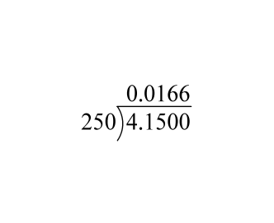
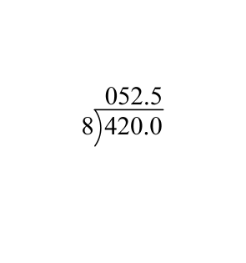
Now do the dividing for the first two!
1) 2)
Click
Click
250
1650
1500
1500
1500
0
40
20
16
40
40
0

Slide 57
21
Divide
0.78 ÷ 0.02 =
39
Notes:
Answer: 39

Slide 58
22
0.6 4.866
8.11
Notes:
Answer: 8.11

Slide 59
23
10 divided by 0.25 =
40
Notes:
Answer: 40

Slide 60
24
12.03 ÷ 0.04 =
300.75
Notes:
Answer: 300.75

Slide 61
25
0.012 24.6
2050
Notes:
Answer: 2050

Slide 62
There are two types of decimals - terminating and repeating.
A terminating decimal is a decimal that ends.
All of the examples we have completed so far are terminating.
A repeating decimal is a decimal that continues forever with one or more digits repeating in a pattern.
To denote a repeating decimal, a line is drawn above the numbers that repeat. However, with a calculator, the last digit is rounded.

Slide 63
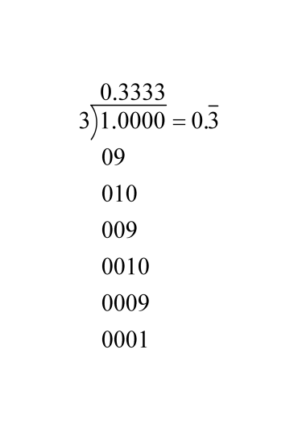
Let's consider the following...
Click to Reveal

Slide 64
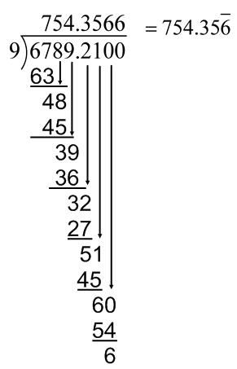
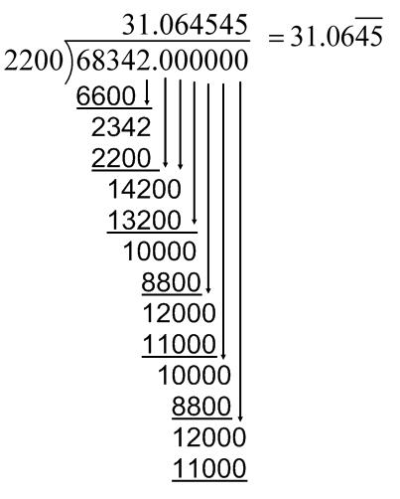
Continue dividing from the problems you set up earlier.
3) 4)
Click to Reveal
Click to Reveal

Slide 65
26
Notes:
Answer: 51.6666…

Slide 66
27
Notes:
Answer: 266.6666…

Slide 67
28
Notes:
Answer: 46.666…

Slide 68
29
Notes:
Answer: 0.00777…

Slide 69
30
Notes:
Answer: 943.333…

Slide 70
31
Notes:
Answer: 19.1333…

Slide 71
Real Life Applications
Return to Table
of Contents

Slide 72
32
You need to put some gas in your car. Regular gasoline is $3.59 per gallon. You only have a $20 bill on you. How many gallons can you buy?
5.571
gallons
Notes:
Answer: 5.571 gallons

Slide 73
33
At Bonita’s Breakfast Emporium, a small latte is $1.45 and a bagel with cream cheese is $3.35 (including tax). If you give the clerk $5 to buy both, how much change will you receive?
$0.20
Notes:
Answer: $0.20

Slide 74
34
Sally won $25.00 for her science fair project. Her project cost $12.57 to prepare. How much did Sally actually make as a profit?
A
$37.57
B
B
$12.43
C
$13.57
D
$12.00
Notes:
Answer: B

Slide 75
35
Five students collected paper to be recycled. Shelly's stack was .008 cm. thick; Ken's stack was .125 cm. thick; Joe's stack was .150 cm. thick; Betty's stack was .185 cm. thick; Mary's stack was .005 cm. thick. What was the thickness of the papers collected to be recycled?
A
.561 cm.
D
B
.452 cm.
C
.480 cm.
D
.473 cm.
Notes:
Answer: D

Slide 76
36
The regular price of a pair of jeans is $29.99. Mrs. Jones has four children for whom she must buy new jeans. The jeans are on sale for $22.50.
What would the total cost be of four pairs of
jeans on sale?
A
$119.96
B
B
$90.00
C
$86.00
D
$52.49
Notes:
Answer: B

Slide 77
37
You want to share 40 cookies with your class. If there are 18 students in the class, how many cookies does each student receive? Make sure your answer is exact!
2 cookies
Notes:
Answer: 2 cookies

Slide 78
38
You need to buy 6 notebooks that cost $0.87 each. How much will this cost?
$5.22
Notes:
Answer: $5.22

Slide 79
39
If you buy two movie tickets for $8.25 each, what will your change be from $20?
$3.50
Notes:
Answer: $3.50

Slide 80
40
Heather has 5.5 lbs of jelly beans. She will put them in 8.5 bags. How much will be in each bag?
0.647 lbs
Notes:
Answer: 0.647 lbs

Slide 81
41
If 6 people are on an elevator and together they weight 931.56 pounds, find the average weight of each person.
155.26 pounds
Notes:
Answer: 155.26 pounds

Slide 82
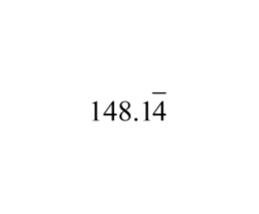
42
What is your average speed in miles per hour if you travel 1333.3 miles in 9 hours?
mph
Notes:
Answer: 148.14444… mph

Slide 83
43
How many inches are there in 40.386 centimeters? (There are 2.54 centimeters per inch)
15.9 inches
Notes:
Answer: 15.9 inches

Slide 84
44
If 8.5 pounds of cheese cost $58.65 what is the price of one pound of cheese?
$6.90
Notes:
Answer: $6.90

Slide 85
45
For your sewing project at school, you need to purchase 3.5 yards of fabric. If you spend $9.10 on fabric, how much does one yard cost?
$2.60
Notes:
Answer: $2.60

Slide 86
46
Texas suffered through a heat wave in August 2011. The highest four temperatures (in degrees Fahrenheit) were 103.4, 102.8, 101.9 and 102.5. What was the average temperature for those four days?
102.65 degrees Fahrenheit
Notes:
Answer: 102.65 degrees Fahrenheit

