Slide 1
New Jersey Center for Teaching and Learning
Progressive Mathematics Initiative
This material is made freely available at www.njctl.org and is intended for the non-commercial use of students and teachers. These materials may not be used for any commercial purpose without the written permission of the owners. NJCTL maintains its website for the convenience of teachers who wish to make their work available to other teachers, participate in a virtual professional learning community, and/or provide access to course materials to parents, students and others.
Click to go to website:
www.njctl.org

Slide 2
6th Grade
Dependent & Independent Variables
2012-11-26
www.njctl.org

Slide 3
Setting the PowerPoint View
Use Normal View for the Interactive Elements
To use the interactive elements in this presentation, do not select the Slide Show view. Instead, select Normal view and follow these steps to set the view as large as possible:
On the View menu, select Normal.
Close the Slides tab on the left.
In the upper right corner next to the Help button, click the ^ to minimize the ribbon at the top of the screen.
On the View menu, confirm that Ruler is deselected.
On the View tab, click Fit to Window.
Use Slide Show View to Administer Assessment Items
To administer the numbered assessment items in this presentation, use the Slide Show view. (See Slide 7 for an example.)

Slide 4
Table of Contents
Click on a topic
to go to that section.
Translating to Equations
Dependent and Independent Variables
Equations and Tables
Graphing Equations

Slide 5
Translating to Equations
Return to Table of Contents

Slide 6
An equation is a statement that shows that two mathematical expressions are equal.
These are examples of equations:
12 + a = 15 x / 5 = 10 y = 3x

Slide 7
1
The Dolphins scored 9 more points than the Jets. The Jets scored 34 points. Which equation could be used to find the number of points p that the Jets scored?
A
p + 9 = 34
B
p + 34 = 9
C
p - 9 = 34
D
p - 34 = 9
Notes:
Answer: C

Slide 8
2
Frank earns $8.50 per hour for mowing his neighbors' yards. Last weekend Frank earned $51. Which equation can be used to determine the number of hours h Frank worked last weekend?
A
8.5h = 51
B
51h = 8.5
C
8.5/h = 51
D
h/51 = 8.5
Notes:
Answer: A

Slide 9
3
Melinda and her friends went to the theater and purchased 3 adult tickets and one large popcorn. One adult ticket costs $9, and they spent $33.75 at the theater. Which equation could be used to determine the cost c of the popcorn?
A
9c - 3 = 33.75
B
33.75-9 = c
C
3c + 9 = 33.75
D
3(9) + c = 33.75
Notes:
Answer: D

Slide 10
Dependent and Independent Variables
Return to Table of Contents

Slide 11
Vocabulary
An independent variable is one that is not influenced by another variable.
The value of a dependent variable relies on the values of the independent variable.

Slide 12
Example
Frank earns $8 per hour mowing his neighbors' lawns.
The amount of money he earns m,
depends on how many hours he works h.
The more hours he works, the more money he earns.
Therefore the dependent variable is money m,
and the independent variable is hours h.
The amount of hours he works does not rely on the money he earns.

Slide 13
Try to guess the missing variable.
Independent | Dependent
how far you drive | how much gas you use
weight of child | amount of dosage
your test score | how you study for the test
With your group, try to think of at least three examples of independent and dependent variables?
Click
Independent | Dependent

Slide 14
4
The number of tickets I can buy depends on how much money I have.
A
True
B
False
Notes:
Answer: True

Slide 15
Click for Question
The number of tickets I can buy depends
on how much money I have.
5
So which value is the independent variable?
A
amount of money
B
number of tickets
Notes:
Answer: A

Slide 16
6
It costs $4.25 to rent a movie. The amount of money I spend depends on how many movies I rent.
So the dependent variable is the number of movies I rent.
A
True
B
False
Notes:
Answer: True

Slide 17
7
The older I get, the taller I am.
My height is the...
A
Independent Variable
B
Dependent Variable
Notes:
Answer: B

Slide 18
8
The more people I have at my party, the more brownies I need to bake. The number of people at my party is the...
A
Independent Variable
B
Dependent Variable
Notes:
Answer: A

Slide 19
Equations and Tables
Return to Table of Contents

Slide 20
The relationship between dependent and independent variables can be represented with a table.
Independent | Dependent
Input | Output
The independent variable is always in the left column, and the dependent variable is always in the right column.
The relationship between independent & dependent variables and input & output works like a machine.

Slide 21
The value of the output relies on
1. The value of the input
2. The rule
Input
Output
Rule
The rule is the relationship between the input and the output.
It says what happens to the input inside the machine.
The value of the output always depends on the value of the input.

Slide 22
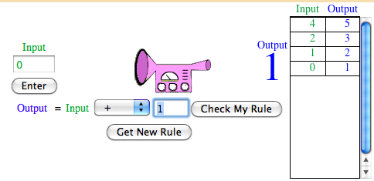
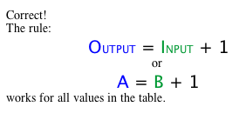
Let's Practice figuring out the rule.
Step 1.
Assign a value to the input.
The input
and output
values
will show
on
this table.
Step 2.
Hit Enter to see the output.
Step 3. Once you have enough input/output values to figure
out the rule, select + or * and the addend or factor.
Click here
for online
practice.
Step 4.
Check Your Rule

Slide 23
The value of n is the input.
Given the value for n, find the output using the given rule.
Input
Output
n
2n
20
40
click
40
80
click
100
200
click

Slide 24
The manager of the department store raised the price $15 on each video game.
Original price
Price after mark up
click
$100
$115
click
$70
$55
click
$53
$38
x
click
x + 15
Can you find an expression (rule) that will satisfy the total cost of the video game if given the original price?
Notes:
Teacher’s instructions: The price after mark up is $15 more, so the expression which satisfies the situation is x +15.

Slide 25
A parent wants to figure out the differences in grade level of her two sons. The younger son is two years behind the older one in terms of grade level.
older son's
grade level
younger son's
grade level
6
click
4th grade
10
click
8th grade
2
click
Kindergarten
g
click
g - 2
Write an expression (rule) containing a variable which satisfies the difference in grade level of the two boys.
Notes:
Teacher’s instructions: The expression is g - 2 because the younger child is two years less than the older child's grade level.

Slide 26
Tables can be used to represent equations.
The table below represents the equation
y = x + 3.
x | y
3 | 6
4 | 7
6 | 9
The output (y) depends on the input (x).
So x is the independent variable, on the left,
and y is the dependent variable, on the right.

Slide 27
This table represents the equation
t = n + 11
Find the values for t, given the values for n.
n
t
10
21
click
28
39
click
40
51
click

Slide 28
This table represents the equation
y = x - 60
Find the values for y, given the values for n.
x
y
80
20
click
120
60
click
180
120
click

Slide 29
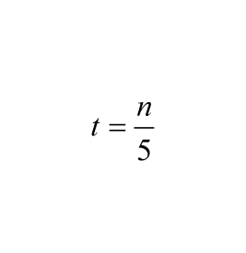
This table represents the equation
Find the values for t, given the values for n.
n
t
20
40
80

Slide 30
This table represents the equation
y = 2x
Find the values for y, given the values for x.
x
y
20
40
click
40
80
click
100
200
click

Slide 31
Equations and tables can also be used to represent real-life information mathematically.
Natalie is going ice skating.
The skating rink charges $6.25 per hour of skating.
We will let h represent the number of hours of skating and c represent the total cost.
Equation: c = 6.25 h
hours (h) | cost (c)
1 | $6.25
2 | $12.50
3 | $18.75

Slide 32
Mary's age is twice the age of Jack.
Can you think of an algebraic equation which
determines Mary's age (m), given Jack's age (j)?
Jack's Age
Mary's Age
12
24
click
14
28
click
24
48
click
a
2a
click
Notes:
Teacher’s in.structions: Mary is "2 times" Jack's age. m = 2j

Slide 33
The manager of the department store raised the price $15 on each video game.
Can you find an equation that will satisfy the total cost of the video game (t) if given the original price (p)?
Original price (p)
Price after mark up (t)
$100
$115
click
$55
$70
click
$38
$53
click
x
x + 15
click
Notes:
Teacher’s instructions: The price after mark up is $15 more, so the equation which satisfies the situation is
t = p + 15.

Slide 34
9
Henry downloads songs into iTunes. The amount of time it takes him to download a song depends on the song's file size.
Which is the independent variable?
A
Download time
B
File size
Notes:
Answer: B

Slide 35
10
If it takes 50 seconds to download one megabyte, which equation represents this scenario ? Use the variable t for download time and s for file size.
A
s = 50t
B
t = 50s
C
50 - s = t
Notes:
Answer: B

Slide 36
11
Which table represents the equation t = 50s ?
A
B
s | t
200 | 4
100 | 2
50 | 1
s | t
4 | 200
5 | 250
6 | 300
C
D
s | t
200 | 150
100 | 50
50 | 1
s | t
1 | 51
2 | 52
3 | 53
Notes:
Answer: B

Slide 37
12
Find the missing value in this table.
It takes Jonathan 6 minutes to run a mile. Let t represent the number of minutes and d represent the number of miles.
(t) | (d)
6 | 1
18 | ?
Notes:
Answer: 3

Slide 38
13
Use the equation y = 5x to complete the table.
x | y
20 | ?
? | 150
50 | ?
A
?= 4 ?= 30 ?= 250
B
?= 4 ?= 30 ?= 10
C
?= 100 ?= 30 ?= 250
D
?= 100 ?= 3 ?= 10
Notes:
Answer: C

Slide 39
Graphing Equations
Return to Table of Contents

Slide 40
You have learned that equations and tables are two ways to represent real-life scenarios.
Equations and tables can also be graphed to represent a real-life scenario.
Example:
A cafeteria has an automatic waffle-making machine. The table shows the relationship between the time in hours (x) and the number of waffles the machine can make (y).
(x) | (y)
1 | 50
2 | 100
3 | 150
4 | 200
5 | 250

Slide 41
The equation for this scenario is
y = 50x
Each hour, 50 waffles are made.
(x) | (y)
1 | 50
2 | 100
3 | 150
4 | 200
5 | 250
The value of y depends on the value of x.
y is dependent x is independent
This scenario can be represented with a graph.
click
When graphing:
The independent variable is always across the x axis.
The dependent variable is always up the y axis.

Slide 42
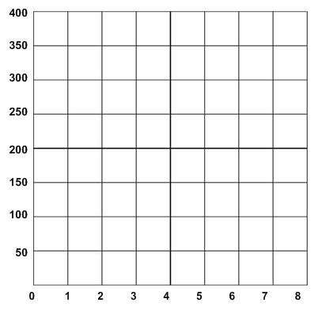
Once you have represented the equation in a function table, you can utilize the independent and dependent variable values as coordinates.
Plot the coordinates from the table below to graph the scenario.
Time (x) | Waffles Made (y)
1 | 50
2 | 100
3 | 150
4 | 200
5 | 250

Slide 43
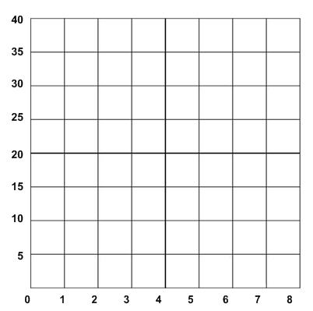
A bookstore is running a special and
is charging $5 for any childrens' book.
1. Write an equation to represent the scenario.
2. Complete the table to represent the scenario.
3. Graph the function.
# of Books (x) | Total Cost (y)
1

Slide 44
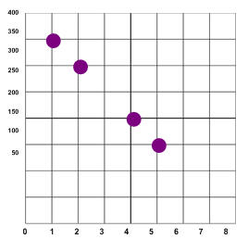
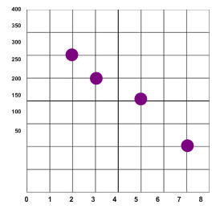
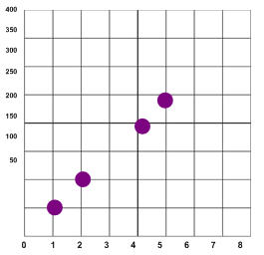
14
A plane descends at a rate of 50 feet per minute. Which graph represents this scenario?
A
B
C
Notes:
Answer: A

Slide 45
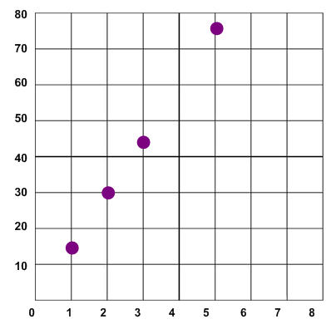
15
Which scenario does the graph represent?
A
Mia earns $12 per hour.
B
The river rose at a steady rate of 15 feet per hour.
C
The stock value decreased by $.50 per minute
D
The plane traveled 300 miles per hour.
Notes:
Answer: B

Slide 46
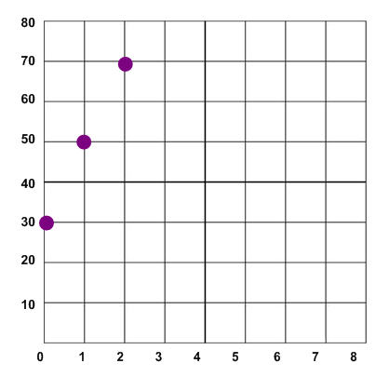
16
Which scenario does the graph represent?
A
Tia starts out with $30. Every hour Tia earns an additional $20.
B
Tia starts out with $50. Every minute she spends $5.
C
Tia runs a mile every 20 minutes.
Notes:
Answer: A

Slide 47
17
A dogwood tree grew at the rate of 4 feet per year. Which table represents the relationship between the height of the tree (h) and the number of years (t)?
A
B
t | h
t | h
t | h
1 | 4
2 | 5
3 | 6
t | h
1 | 4
3 | 12
5 | 20
C
D
t | h
5 | 1
10 | 2
15 | 3
t | h
4 | 1
8 | 2
12 | 3
Notes:
Answer: B

Slide 48
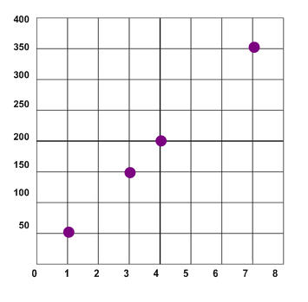
18
The table and graph represent which equation?
minutes (x) | 1 | 3 | 4 | 7
# of words typed (y) | 50 | 150 | 200 | 350
A
y = 50x
B
50y = x
C
y = x - 50
D
y = x + 50
Notes:
Answer: A

