Slide 1

New Jersey Center for Teaching and Learning
Progressive Mathematics Initiative
This material is made freely available at www.njctl.org and is intended for the non-commercial use of students and teachers. These materials may not be used for any commercial purpose without the written permission of the owners. NJCTL maintains its website for the convenience of teachers who wish to make their work available to other teachers, participate in a virtual professional learning community, and/or provide access to course materials to parents, students and others.
Click to go to website:
www.njctl.org

Slide 2
6th Grade
Fractions
2012-06-25
www.njctl.org

Slide 3
Setting the PowerPoint View
Use Normal View for the Interactive Elements
To use the interactive elements in this presentation, do not select the Slide Show view. Instead, select Normal view and follow these steps to set the view as large as possible:
On the View menu, select Normal.
Close the Slides tab on the left.
In the upper right corner next to the Help button, click the ^ to minimize the ribbon at the top of the screen.
On the View menu, confirm that Ruler is deselected.
On the View tab, click Fit to Window.
Use Slide Show View to Administer Assessment Items
To administer the numbered assessment items in this presentation, use the Slide Show view. (See Slide 18 for an example.)

Slide 4
Fractions Unit Topics
Greatest Common Factor
Click on the topic to go to that section
Least Common Multiple
GCF and LCM Word Problems
Distribution
Fraction Operations Review (+ - x)
Fraction Operations Division
Fraction Operations Mixed Application
Common Core Standards: 6.NS.1, 6.NS.4

Slide 5
Greatest Common
Factor
Return to
Table of
Contents

Slide 6
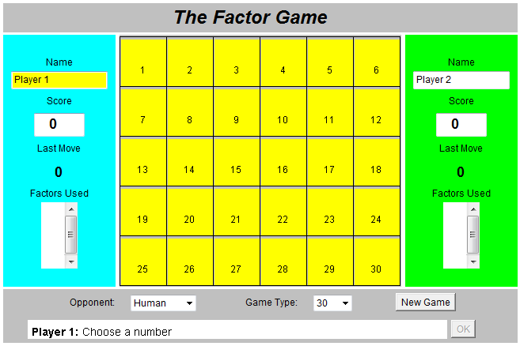
Interactive Website
Review of factors, prime and composite numbers
Play the Factor Game a few times with a partner. Be sure to take turns going first. Find moves that will help you score more points than your partner. Be sure to write down strategies or patterns you use or find.
Answer the Discussion Questions.

Slide 7
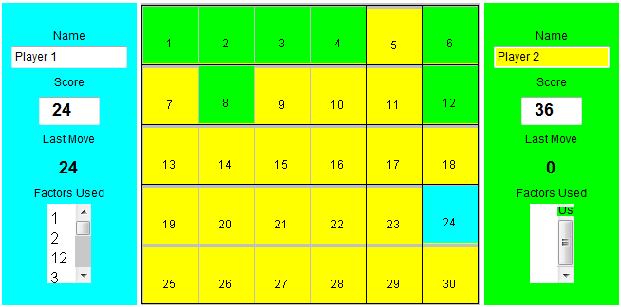
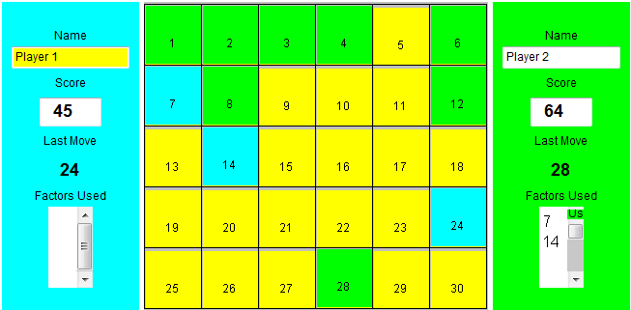
Player 1 chose 24 to earn 24 points.
Player 2 finds 1, 2, 3, ,4, 6, 8, 12 and earns 36 points.
Player 2 chose 28 to earn 28 points.
Player 1 finds 7 and 14 are the only available factors and earns 21 points.

Slide 8
Discussion Questions
1. Make a table listing all the possible first moves, proper
factors, your score and your partner's score. Here's an example:
2. What number is the best first move? Why?
3. Choosing what number as your first move would make you
lose your next turn? Why?
4. What is the worst first move other than the number you
chose in Question 3?
First Move | Proper Factors | My Score | Partner's Score
1 | None | Lose a Turn | 0
2 | 1 | 2 | 1
3 | 1 | 3 | 1
4 | 1, 2 | 4 | 3
more questions

Slide 9
5. On your table, circle all the first moves that only allow your
partner to score one point. These numbers have a special
name. What are these numbers called?
Are all these numbers good first moves? Explain.
6. On your table, draw a triangle around all the first moves that
allow your partner to score more than one point. These
numbers also have a special name. What are these numbers
called?
Are these numbers good first moves? Explain.

Slide 10
Activity
Party Favors!
You are planning a party and want to give your guests party favors. You have 24 chocolate bars and 36 lollipops.
Discussion Questions
What is the greatest number of party favors you can make if each bag must have exactly the same number of chocolate bars and exactly the same number of lollipops? You do not want any candy left over. Explain.
Could you make a different number of party favors so that the candy is shared equally? If so, describe each possibility.
Which possibility allows you to invite the greatest number of guests? Why?
Uh-oh! Your little brother ate 6 of your lollipops. Now what is the greatest number of party favors you can make so that the candy is shared equally?
Notes:
Teacher Note: Give each student (or group) a bag filled with items to be separated into party favors for their guests. Each bag should contain 24 “chocolate bars” and 36 “lollipops”. (Use counters or tiles. Numbers may be changed.)

Slide 11
Greatest Common Factor
We can use prime factorization to find the greatest common factor (GCF).
1. Factor the given numbers into primes.
2. Circle the factors that are common.
3. Multiply the common factors together to find the greatest
common factor.

Slide 12
Use prime factorization to find the greatest common factor of 12 and 16.
12 16
3 4 4 4
3 2 2 2 2 2 2
12 = 2 x 2 x 3 16 = 2 x 2 x 2 x 2
X
The Greatest Common Factor is 2 x 2 = 4
Notes:
Teacher Instructions:
Factor the given number into primes.
Circle factors that are common.
Multiply the common factors together to find the greatest common factor.

Slide 13
Another way to find Prime Factorization...
Use prime factorization to find the greatest common factor of 12 and 16.
2
X
16
2
12
2
8
2
6
2
4
3
3
2
2
1
1
12 = 2 x 2 x 3
16 = 2 x 2 x 2 x 2
The Greatest Common Factor is 2 x 2 = 4
Notes:
Teacher Instructions:
1. Factor the given number into primes.
2. Circle factors that are common.
3. Multiply the common factors together to find the greatest common factor.

Slide 14
Use prime factorization to find the greatest common factor of 36 and 90.
36 90
6 6 9 10
2 3 2 3 3 3 2 5
36 = 2 x 2 x 3 x 3 90 = 2 x 3 x 3 x 5
x
GCF is 2 x 3 x 3 = 18
Notes:
Teacher Instructions:
1. Factor the given number into primes.
2. Circle factors that are common.
3. Multiply the common factors together to find the greatest common factor.

Slide 15
Use prime factorization to find the greatest common factor of 36 and 90.
X
2
36
2
90
2
18
3
45
3
9
3
15
3
3
5
5
1
1
36 = 2 x 2 x 3 x 3
90 = 2 x 3 x 3 x 5
GCF is 2 x 3 x 3 = 18
Notes:
Teacher Instructions:
Factor the given number into primes.
Circle factors that are common.
3. Multiply the common factors together to find the greatest common factor.

Slide 16
Use prime factorization to find the greatest common factor of 60 and 72.
60 72
6 10 6 12
2 3 2 5 2 3 3 4
2 3 2 5 2 3 3 2 2
60 = 2 x 2 x 3 x 5 72 = 2 x 2 x 2 x 3 x 3
X
GCF is 2 x 2 x 3 = 12
Notes:
Teacher Instructions:
1. Factor the given number into primes.
2. Circle factors that are common.
3. Multiply the common factors together to find the greatest common factor.

Slide 17
Use prime factorization to find the greatest common factor of 60 and 72.
X
2
60
2
72
2
30
2
36
3
15
2
18
5
5
3
9
1
3
3
1
60 = 2 x 2 x 3 x 5
72 = 2 x 2 x 2 x 3 x 3
GCF is 2 x 2 x 3 = 12
Notes:
Teacher Instructions:
1. Factor the given number into primes.
2. Circle factors that are common.
3. Multiply the common factors together to find the greatest common factor.

Slide 18
1
Find the GCF of 18 and 44.
Notes:
Answer: 2

Slide 19
2
Find the GCF of 28 and 70.
Notes:
Answer: 14

Slide 20
3
Find the GCF of 55 and 110.
Notes:
Answer: 55

Slide 21
4
Find the GCF of 52 and 78.
Notes:
Answer: 26

Slide 22
5
Find the GCF of 72 and 75.
Notes:
Answer: 3

Slide 23
Relatively Prime:
Two or more numbers are relatively prime if
their greatest common factor is 1.
Example:
15 and 32 are relatively prime because their GCF is 1.
Name two numbers that are relatively prime.

Slide 24
6
7 and 35 are not relatively prime.
True
False
Notes:
Answer: True

Slide 25
7
Identify at least two numbers that are relatively prime to 9.
A
16
B
15
C
28
D
36
Notes:
Answer: A and C

Slide 26
8
Name a number that is relatively prime to 20.
Notes:
Answer: Answers will vary.

Slide 27
9
Name a number that is relatively prime to 5 and 18.
Notes:
Answer: Answers may vary.

Slide 28
10
Find two numbers that are relatively prime.
A
7
B
14
C
15
D
49
Notes:
Answer: A and C, B and C, C and D

Slide 29
Least Common
Multiple
Return to
Table of
Contents

Slide 30
Text-to-World Connection
1. Use what you know about factor pairs to evaluate George
Banks' mathematical thinking? Is his thinking accurate? What
mathematical relationship is he missing?
2. How many hot dogs came in a pack? Buns?
3. How many "superfluous" buns did George Banks remove from
each package? How many packages did he do this to?
4. How many buns did he want to buy? Was his thinking correct?
Did he end up with 24 hot dog buns?
5. Was there a more logical way for him to do this? What was he
missing?
6. What is the significance of the number 24?
Notes:
Teacher Note: Show students a real-life scenario involving least common multiples. Search for the movie clip from “Father of the Bride” where George Banks is shopping for hot dogs and buns.
George Banks identified 8 & 3 as a factor pair of 24, but overlooked the factor pair 12 & 2.

Slide 31
A multiple of a whole number is the product of the number and any nonzero whole number.
A multiple that is shared by two or more numbers is a common multiple.
Multiples of 6: 6, 12, 18, 24, 30, 36, 42, 48, ...
Multiples of 14: 14, 28, 42, 56, 70, 84,...
The least of the common multiples of two or more numbers is the least common multiple (LCM). The LCM of 6 and 14 is 42.

Slide 32
There are 2 ways to find the LCM:
List the multiples of each number until you find the first
one they have in common.
Write the prime factorization of each number. Multiply all
factors together. Use common factors only once (in other
words, use the highest exponent for a repeated factor).

Slide 33
EXAMPLE: 6 and 8
Multiples of 6: 6, 12, 18, 24, 30
Multiples of 8: 8, 16, 24
LCM = 24
Prime Factorization:
6 8
2 3 2 4
2 2 2
2 3 2³ LCM: 2³ 3 = 8 3 = 24

Slide 34
Find the least common multiple of 18 and 24.
Multiples of 18: 18, 36, 54, 72, ...
Multiples of 24: 24, 48, 72, ...
LCM: 72
X
Prime Factorization:
18 24
2 9 6 4
2 3 3 3 2 2 2
2 3² 2³ 3 LCM: 2³ 3² = 8 9 = 72

Slide 35
11
Find the least common multiple of 10 and 14.
A
2
B
20
C
70
D
140
Notes:
Answer: C

Slide 36
12
Find the least common multiple of 6 and 14.
A
10
B
30
C
42
D
150
Notes:
Answer: C

Slide 37
13
Find the least common multiple of 9 and 15.
A
3
B
30
C
45
D
135
Notes:
Answer: C

Slide 38
14
Find the least common multiple of 6 and 9.
A
3
B
12
C
18
D
36
Notes:
Answer: C

Slide 39
15
Find the least common multiple of 16 and 20.
A
80
B
100
C
240
D
320
Notes:
Answer: A

Slide 40
16
Find the LCM of 12 and 20.
Notes:
Answer: 60

Slide 41
17
Find the LCM of 24 and 60.
Notes:
Answer: 120

Slide 42
18
Find the LCM of 15 and 35.
Notes:
Answer: 105

Slide 43
19
Find the LCM of 24 and 32.
Notes:
Answer: 96

Slide 44
20
Find the LCM of 15 and 35.
Notes:
Answer: 105

Slide 45
21
Find the GCF of 20 and 75.
Notes:
Answer: 5

Slide 46
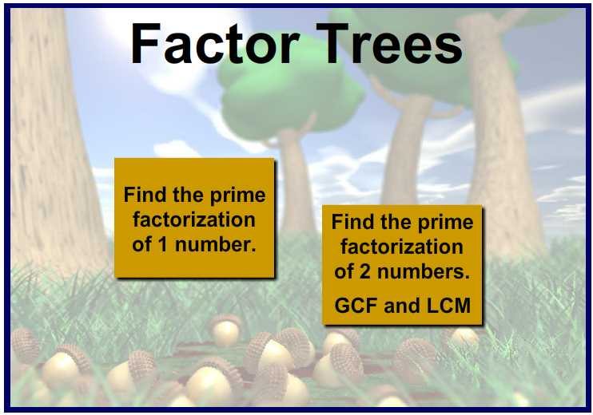
Interactive Website
Uses a venn diagram to find the GCF and LCM for extra practice.

Slide 47
GCF and LCM Word Problems
Return to
Table of
Contents

Slide 48
How can you tell if a word problem requires you to use Greatest Common Factor or Least Common Multiple to solve?

Slide 49
GCF Problems
Do we have to split things into smaller sections?
Are we trying to figure out how many people we can invite?
Are we trying to arrange something into rows or groups?

Slide 50
LCM Problems
Do we have an event that is or will be repeating over and over?
Will we have to purchase or get multiple items in order to have enough?
Are we trying to figure out when something will happen again at the same time?

Slide 51
Samantha has two pieces of cloth. One piece is 72 inches wide and the other piece is 90 inches wide. She wants to cut both pieces into strips of equal width that are as wide as possible. How wide should she cut the strips?
What is the question: How wide should she cut the strips?
Important information: One cloth is 72 inches wide.
The other is 90 inches wide.
Is this a GCF or LCM problem?
Does she need smaller or larger pieces?
This is a GCF problem because we are cutting or "dividing" the pieces of cloth into smaller pieces (factor) of 72 and 90.

Slide 52
Bar Modeling
Use the greatest common factor to determine the greatest width possible.
The greatest common factor represents the greatest width possible not the number of pieces, because all the pieces need to be of equal length.
72 inches
90 inches
click
18 inches
Notes:
Teacher Notes: Use the rectangle to show the division of the pieces.

Slide 53
Ben exercises every 12 days and Isabel every 8 days. Ben and Isabel both exercised today. How many days will it be until they exercise together again?
What is the question: How many days until they exercise together again?
Important information: Ben exercises every 12 days
Isabel exercises every 8 days
Is this a GCF or LCM problem?
Are they repeating the event over and over or splitting up the days?
This is a LCM problem because they are repeating the event to find out when they will exercise together again.

Slide 54
Bar Modeling
Use the least common multiple to determine the least amount of days possible.
The least common multiple represents the number of days not how many times they will exercise.
Ben exercises in:
12 Days
Isabel exercises in:
8 Days
Notes:
Drag the rectangles until you create two bars of equal length.

Slide 55
22
Mrs. Evans has 90 crayons and 15 pieces of paper to give to her students. What is the largest number of students she can have in her class so that each student gets an equal number of crayons and an equal number of paper?
A
GCF Problem
B
LCM Problem
Notes:
Answer A

Slide 56
23
Mrs. Evans has 90 crayons and 15 pieces of paper to give to her students. What is the largest number of students she can have in her class so that each student gets an equal number of crayons and an equal number of paper?
A
3
B
5
C
15
D
90
Notes:
Answer C

Slide 57
24
How many crayons and pieces of paper does each student receive?
A
30 crayons and 10 pieces of paper
B
12 crayons and pieces of paper
C
18 crayons and 6 pieces of paper
D
6 crayons and 1 piece of paper
Challenge problems are notated with a star.
Notes:
Answer D

Slide 58
25
Rosa is making a game board that is 16 inches by 24 inches. She wants to use square tiles. What is the largest tile she can use?
A
GCF Problem
B
LCM Problem
Notes:
Answer A

Slide 59
26
Rosa is making a game board that is 16 inches by 24 inches. She wants to use square tiles. What is the largest tile she can use?
Notes:
Answer: 8 inch square tiles

Slide 60
27
How many tiles will she need?
Notes:
Answer: 6 tiles

Slide 61
28
Y100 gave away a $100 bill for every 12th caller. Every 9th caller received free concert tickets. How many callers must get through before one of them receives both a $100 bill and a concert ticket?
A
GCF Problem
B
LCM Problem
Notes:
Answer B

Slide 62
29
Y100 gave away a $100 bill for every 12th caller. Every 9th caller received free concert tickets. How many callers must get through before one of them receives both a $100 bill and a concert ticket?
A
36
B
3
C
108
D
6
Notes:
Answer: A

Slide 63
30
There are two ferris wheels at the state fair. The children's ferris wheel takes 8 minutes to rotate fully. The bigger ferris wheel takes 12 minutes to rotate fully. Marcia went on the large ferris wheel and her brother Joey went on the children's ferris wheel. If they both start at the bottom, how many minutes will it take for both of them to meet at the bottom at the same time?
A
GCF Problem
B
LCM Problem
Notes:
Answer: B

Slide 64
31
There are two ferris wheels at the state fair. The children's ferris wheel takes 8 minutes to rotate fully. The bigger ferris wheel takes 12 minutes to rotate fully. Marcia went on the large ferris wheel and her brother Joey went on the children's ferris wheel. If they both start at the bottom, how many minutes will it take for both of them to meet at the bottom at the same time?
A
2
B
4
C
24
96
D
Notes:
Answer: C

Slide 65
32
How many rotations will each ferris wheel complete before they meet at the bottom at the same time?
Notes:
Answer: The small ferris wheel will complete 3 rotations and the large ferris wheel will complete 2 rotations in 24 minutes.

Slide 66
33
Sean has 8-inch pieces of toy train track and Ruth has 18-inch pieces of train track. How many of each piece would each child need to build tracks that are equal in length?
GCF Problem
A
B
LCM Problem
Notes:
Answer: B

Slide 67
34
What is the length of the track that each child will build?
Notes:
Answer: 72 inches

Slide 68
35
I am planting 50 apple trees and 30 peach trees. I want the same number and type of trees per row. What is the maximum number of trees I can plant per row?
GCF Problem
A
B
LCM Problem
Notes:
Answer: A

Slide 69
Distribution
Return to
Table of
Contents

Slide 70
Which is easier to solve?
28 + 42 7(4 + 6)
Do they both have the same answer?
You can rewrite an expression by removing a common factor. This is called the Distributive Property.

Slide 71
The Distributive Property allows you to:
1. Rewrite an expression by factoring out the GCF.
2. Rewrite an expression by multiplying by the GCF.
EXAMPLE
Rewrite by factoring out the GCF:
45 + 80 28 + 63
5(9 + 16) 7(4 + 9)
Rewrite by multiplying by the GCF:
3(12 + 7) 8(4 + 13)
36 + 21 32 + 101

Slide 72
Use the Distributive Property to rewrite each expression:
1. 15 + 35 2. 21 + 56 3. 16 + 60
5(3 + 7) 7(3 + 8) 4(4 + 15)
4. 77 + 44 5. 26 + 39 6. 36 + 8
11(7 + 4) 13(2 + 3) 4(9 + 2)
Click to
Reveal
Click to
Reveal
Click to
Reveal
Click to
Reveal
Click to
Reveal
Click to
Reveal
REMEMBER you need to factor the GCF
(not just any common factor)!

Slide 73
36
In order to rewrite this expression using the Distributive Property, what GCF will you factor?
56 + 72
Notes:
Answer: 8

Slide 74
37
In order to rewrite this expression using the Distributive Property, what GCF will you factor?
48 + 84
Notes:
Answer: 12

Slide 75
38
In order to rewrite this expression using the Distributive Property, what GCF will you factor?
45 + 60
Notes:
Answer: 15

Slide 76
39
In order to rewrite this expression using the Distributive Property, what GCF will you factor?
27 + 54
Notes:
Answer: 27

Slide 77
40
In order to rewrite this expression using the Distributive Property, what GCF will you factor?
51 + 34
Notes:
Answer: 17

Slide 78
41
Use the distributive property to rewrite this expression:
36 + 84
A
3(12 + 28)
B
4(9 + 21)
C
2(18 + 42)
D
12(3 + 7)
Notes:
Answer: D

Slide 79
42
Use the distributive property to rewrite this expression:
88 + 32
A
4(22 + 8)
B
8(11 + 4)
C
2(44 + 16)
D
11(8 + 3)
Notes:
Answer: B

Slide 80
43
Use the distributive property to rewrite this expression:
40 + 92
A
2(20 + 46)
B
4(10 + 23)
C
8(5 + 12)
D
5(8 + 19)
Notes:
Answer: B

Slide 81
Fraction Operations
Return to
Table of
Contents

Slide 82
Let's review what we know about fractions...
Discuss in your groups how to do the following and be prepared to share with the rest of the class.
Add Fractions
Click link to go to review page followed by practice problems
Subtract Fractions
Multiply Fractions

Slide 83
Adding Fractions...
1. Rewrite the fractions with a common denominator.
2. Add the numerators.
3. Leave the denominator the same.
4. Simplify your answer.
Adding Mixed Numbers...
1. Add the fractions (see above steps).
2. Add the whole numbers.
3. Simplify your answer.
(you may need to rename the fraction)
Link Back
to List

Slide 84
44
3
10
2
10
+
Notes:
Answer: 1/2

Slide 85
45
5
8
+
1
8
Notes:
Answer: 3/4

Slide 86
46
7
14
+
3
14
Notes:
Answer: 5/7

Slide 87
47
5
12
2
12
+
Notes:
Answer: 7/12

Slide 88
48
8
20
6
20
+
Notes:
Answer: 7/10

Slide 89
49
4
5
3
5
+
Notes:
Answer: 1 2/5

Slide 90
50
4
9
2
9
+
Notes:
Answer: 2/3

Slide 91
51
Find the sum.
2
5
12
3
2
12
+
Notes:
Answer: 5 7/12

Slide 92
52
Find the sum.
5
3
10
7
5
10
+
Notes:
Answer: 12 4/5

Slide 93
53
Is the equation below true or false?
True
False
1
8
12
+
5
12
Click For reminder
1
Don't forget to regroup to the whole number if you end up with the numerator larger than the denominator.
3
1
12
Notes:
Answer: True

Slide 94
54
Find the sum.
2
4
9
5
2
9
+
Notes:
Answer: 7 2/3

Slide 95
55
Find the sum.
3
3
14
2
4
14
+
Notes:
Answer: 5 1/2

Slide 96
56
Find the sum.
4
3
8
+
2
3
8
Notes:
Answer: 6 3/4

Slide 97
A quick way to find LCDs...
List multiples of the larger denominator and stop when you find a common multiple for the smaller denominator.
Ex: and
Multiples of 5: 5, 10, 15
Ex: and
Multiples of 9: 9, 18, 27, 36
1
3
2
5
X
3
4
2
9

Slide 98


Common Denominators
Another way to find a common denominator is to multiply the two denominators together.
Ex: and 3 x 5 = 15
= =
1
3
2 5
x
1
3
x 5
5
15
2
5
x 3
6
15
x 5
x 3

Slide 99
57
2
5
+
1
3
Notes:
Answer: 11/15

Slide 100
58
3
10
+
2
5
Notes:
Answer: 7/10

Slide 101
59
5
8
+
3
5
Notes:
Answer: 1 9/40

Slide 102
60
3
4
7
9
+
Notes:
Answer: 1 19/36

Slide 103
61
5
7
1
3
+
Notes:
Answer: 1 1/21

Slide 104
62
3
4
2
3
+
Notes:
Answer: 1 5/12

Slide 105
Try this...
9
1
2
+
7
10
Click here
1
5
10

Slide 106
Try this...
3
5
12
+
2
3
4
Click here
6
1
6

Slide 107
63
5
3
4
2
7
12
+
=
7
16
12
8
1
3
A
C
8
4
12
7
5
8
B
D
Notes:
Answer: C

Slide 108
64
2
3
8
5
5
12
=
+
7
19
24
7
8
12
A
C
7
8
20
8
7
12
B
D
Notes:
Answer: A

Slide 109
65
3
1
4
2
1
6
+
=
5
2
10
5
1
2
A
C
5
5
12
6
5
12
B
D
Notes:
Answer: B

Slide 110
66
9
2
5
5
5
6
=
+
14
37
30
14
37
30
A
C
14
7
11
15
7
30
B
D
Notes:
Answer: D

Slide 111
67
1
2
3
2
1
2
+
=
3
3
5
4
7
6
A
C
4
1
6
3
7
6
B
D
Notes:
Answer: B

Slide 112
68
Find the sum.
5
2
10
+
7
4
10
Notes:
Answer: 12 3/5

Slide 113
69
Find the sum.
4
7
8
7
1
4
+
Notes:
Answer: 11 9/8 = 12 1/8

Slide 114
70
2
3
5
10
7
+
14
=
Notes:
Answer: 21 23/18 = 22 5/18

Slide 115
Subtracting Fractions...
1. Rewrite the fractions with a common denominator.
2. Subtract the numerators.
3. Leave the denominator the same.
4. Simplify your answer.
Subtracting Mixed Numbers...
1. Subtract the fractions (see above steps..).
(you may need to borrow from the whole number)
2. Subtract the whole numbers.
3. Simplify your answer.
(you may need to simplify the fraction)
Link Back
to List

Slide 116
71
7
8
4
8
Notes:
Answer: 3/8

Slide 117
72
7
10
3
10
Notes:
Answer: 2/5

Slide 118
73
6
7
4
5
Notes:
Answer: 2/35

Slide 119
74
2
3
1
5
Notes:
Answer: 7/15

Slide 120
75
5
6
3
6
Notes:
Answer: 1/3

Slide 121
76
9
14
5
14
Notes:
Answer: 2/7

Slide 122
77
7
9
5
9
Notes:
Answer: 2/9

Slide 123
78
Is the equation below true or false?
True
False
4
5
9
3
9
3
2
9
Notes:
Answer: False

Slide 124
79
Is the equation below true or false?
True
False
2
7
9
1
1
9
1
2
3
Notes:
Answer: True

Slide 125
80
Find the difference.
4
7
8
2
3
8
Notes:
Answer: 2 1/2

Slide 126
81
Find the difference.
6
7
12
1
4
12
Notes:
Answer: 5 1/4

Slide 127
82
Find the difference.
13
5
8
5
2
8
Notes:
Answer: 8 3/8

Slide 128
83
4
5
1
7
Notes:
Answer: 23/35

Slide 129
84
2
3
1
6
Notes:
Answer: 1/2

Slide 130
85
6
7
3
5
Notes:
Answer: 1/5

Slide 131
86
3
4
5
9
Notes:
Answer: 7/36

Slide 132
87
3
5
1
6
Notes:
Answer: 13/30

Slide 133
88
6
8
4
8
Notes:
Answer: 1/4

Slide 134
Sometimes when you subtract the fractions, you find that you can't because the first numerator is smaller than the second! When this happens, you need to regroup from the whole number.
How many thirds are in 1 whole?
How many fifths are in 1 whole?
How many ninths are in 1 whole?

Slide 135
A Regrouping Review
When you regroup for subtracting, you take one of your whole numbers and change it into a fraction with the same denominator as the fraction in the mixed number.
3
5
=
2
5
5
3
5
=
8
5
3
2
Don't forget to add the fraction you regrouped from your whole number to the fraction already given in the problem.

Slide 136
1
4
3
12
12
12
3
12
15
12
5
5
4
4
x
3
7
12
3
7
12
3
7
12
3
7
12
8
12
1
1
2
3

Slide 137
x
9
8
8
8
4
5
8
4
5
8
4
3
8

Slide 138
89
Do you need to regroup in order to complete this problem?
Yes
No
3
1
2
1
4
Notes:
Answer: No

Slide 139
90
Do you need to regroup in order to complete this problem?
Yes
No
7
2
3
6
3
4
Notes:
Answer: Yes

Slide 140
3
10
91
What does 17 become when regrouping?
Notes:
Answer: 16 13/10

Slide 141
5
8
92
What does 21 become when regrouping?
Notes:
Answer: 20 13/8

Slide 142
93
4
1
6
2
1
4
=
2
1
12
1
11
12
A
C
1
22
24
1
1
12
B
D
Notes:
Answer: C

Slide 143
94
6
2
7
3
2
3
=
3
8
21
2
2
3
A
C
3
13
21
2
13
21
B
D
Notes:
Answer: D

Slide 144
95
15
8
10
12
=
7
5
6
7
1
6
A
C
6
1
6
6
2
12
B
D
Notes:
Answer: B

Slide 145
96
9
5
3
5
=
Notes:
Answer: 3 2/5

Slide 146
97
14
2
7
11
8
21
=
Notes:
Answer: 2 19/21

Slide 147
Adding & Subtracting
Fractions with Unlike Denominators
Applications

Slide 148
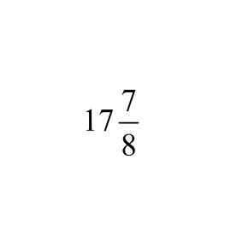
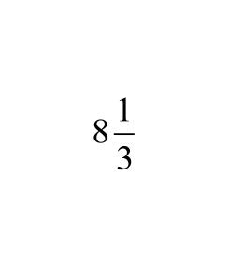
98
Trey has a piece of rope that is feet long.
He cuts off an foot piece of rope and gives
it to his sister for a jump rope. How much rope does Trey have left?
8
13
24
9
13
24
A
C
9
1
4
26
5
24
B
D
Notes:
Answer: C

Slide 149
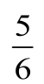
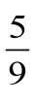
99
The roadrunner of the American Southwest has
a tail nearly as long as its body. What is the
total length of a roadrunner with a body
measuring feet and a tail measuring feet?
Notes:
Answer: 1 7/18

Slide 150
100
Cara uses this recipe for the topping on her blueberry muffins.
1/2 cup sugar
1/3 cup all-purpose flour
1/4 cup butter, cubed
1 1/2 teaspoons ground cinnamon
How much more sugar than flour does Cara use for her topping?
Notes:
Answer: 1/6

Slide 151
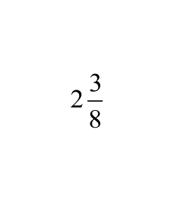
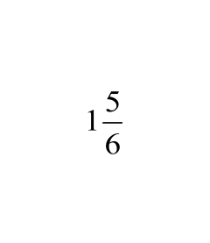
101
Jared's baseball team played a doubleheader.
During the first game, players ate lb. of
peanuts. During the second game, players ate
lb. of peanuts. How many pounds of
Peanuts did the players eat during both games?
Notes:
Answer: 4 5/24

Slide 152

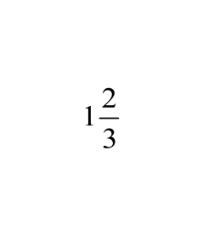
102
Holly made dozen bran muffins and
dozen zucchini muffins. How many dozen muffins did she make in all?
Notes:
Answer: 4 5/12

Slide 153
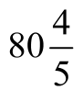
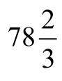
103
The Spider roller coaster has a maximum speed of miles per hour. The Silver Star roller coaster has a maximum speed of miles per hour. How much faster is the Spider than the Silver Star?
Notes:
Answer: 2 2/15

Slide 154
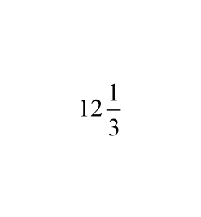

104
Great Work Construction used cubic yards
of concrete for the driveway and cubic
yards of concrete for the patio of a new house.
What is the total amount of concrete used?
Notes:
Answer: 17 5/6

Slide 155
105
Kyle put seven-eighths of a gallon of water into a bucket. Then he put one-sixth of a gallon of liquid cleaner into the bucket. What is the total amount of liquid Kyle put into the bucket?
Notes:
Answer: 1 1/24

Slide 156
Multiplying Fractions...
1. Multiply the numerators.
2. Multiply the denominators.
3. Simplify your answer.
Multiplying Mixed Numbers...
1. Rewrite the Mixed Number(s) as an improper fraction.
(write whole numbers / 1)
2. Multiply the fractions.
3. Simplify your answer.
Link Back
to List

Slide 157
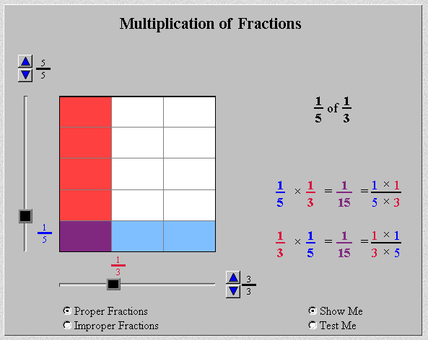
Click for Interactive Practice From
The National Library of Virtual Manipulatives

Slide 158
106
1
5
2
3
x
=
Notes:
Answer: 2/15

Slide 159
107
2
3
3
7
x
=
Notes:
Answer: 2/7

Slide 160
108
5
8
4
7
x
=
Notes:
Answer: 5/14

Slide 161
(
)
109
2
11
5
6
=
Notes:
Answer: 5/33

Slide 162
(
)
110
4
9
3
8
=
Notes:
Answer: 1/6

Slide 163
111
1
2
5
1
1
2
5
x
=
x
True
False
Notes:
Answer: True

Slide 164
112
3
x
4
7
12
21
1
5
7
A
C
12
7
3
5
7
B
D
Notes:
Answer: C

Slide 165
113
12
x
8
9
32
3
96
9
A
C
11
1
3
10
2
3
B
D
Notes:
Answer: D

Slide 166
114
1
4
1
8
6
3
8
x
2
3
=
True
False
Notes:
Answer: False

Slide 167
115
8
x
5
1
2
44
1
2
A
C
44
40
1
2
88
2
B
D
Notes:
Answer: C

Slide 168
(
)
(
)
116
5
5
8
3
2
5
15
1
4
20
3
8
A
C
18
1
8
19
1
8
B
D
Notes:
Answer: D

Slide 169
Salad Dressing Recipe
1/4 cup sugar
1 1/2 teaspoon paprika
1 teaspoon dry mustard
1 1/2 teaspoon salt
1/8 teaspoon onion powder
3/4 cup vegetable oil
1/4 cup vinegar
What fraction of a cup of vegetable oil should Julia use to make 1/2 of a batch of salad dressing?
X
She needs 1/2 of 3/4 cup vegetable oil.
1
2
x
3
4
=
3
8
of

Slide 170
Carl worked on his math project for 5 1/4 hours. April worked 1 1/2 times as long on her math project as Carl. For how many hours did April work on her math project?
X
1
1
2
x
5
1
4
as long as
3
2
63
8
7
8
21
4
x
=
=
7

Slide 171
7
10
Tom walks 3 miles each day. What is the total
number of miles he walks in 31 days?
7
10
x
X
3
miles each day for
31 days
37
10
31
1
1147
10
7
10
x
=
=
114

Slide 172
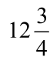
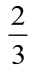
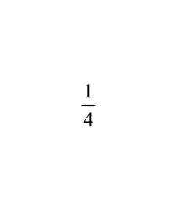
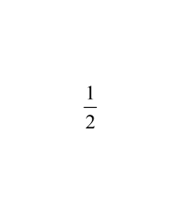
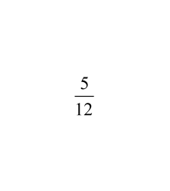
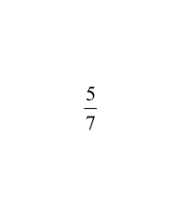
117
Jared made cups of snack mix for a party.
His guests ate of the mix. How much snack
mix did his guests eat?
A
5 cups
B
8 cups
C
4 cups
D
12 cups
Notes:
Answer: B

Slide 173
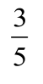
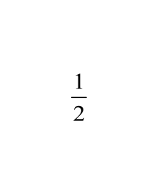
118
Sasha still has of a scarf left to knit. If she
finishes of the remaining part of the scarf
today, how much does she have left to knit?
Notes:
Answer: 3/10

Slide 174
119
4
5
In Zoe's class, of the students have pets. Of the
students who have pets, have rodents. What
fraction of the students in Zoe's class have
rodents?
1
8
1
40
2
5
A
C
B
1
10
D
1
2
Notes:
Answer: B

Slide 175
120
7
8
Beth hiked for hours at an average rate of
miles per hour. Which is the best estimate
of the distance that she hiked?
3
3
1
4
A
9 miles
B
10 miles
C
12 miles
D
16 miles
C
D
16 miles
Notes:
Answer: C

Slide 176
1
2
121
Clark's muffin recipe calls for cups of flour
for a dozen muffins and cup of flour for the
topping. If he makes of the original recipe,
how much flour will she use altogether?
1
1
4
1
1
3
Notes:
Answer: 2 1/3

Slide 177
Fraction Operations
Division
Return to
Table of
Contents

Slide 179



Slide 181
122 Evaluate the following problem using the model below:
Notes:
Answer:
12

Slide 182
123 Evaluate the following problem using the model below:
Notes:
Answer:
10

Slide 185
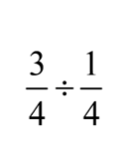
124 Evaluate the following problem using the model below:
Notes:
Answer:
3

Slide 186
125 Evaluate the following problem using the model below:
Notes:
Answer:
5

Slide 188
Notes:
Note:
Discuss Patterns either from model or number sentence

Slide 189
If you think about it, we are dividing by a fraction which creates a complex fraction.
You need to eliminate the fraction in the denominator in order to solve the problem.
To do this, multiply the numerator and denominator of the complex fraction by the reciprocal of the denominator (making the denominator = 1).
You can then simplify the fraction by rewriting it without the denominator of 1 and solve the new multiplication problem.

Slide 194
Checking Your Answer
To check your answer, use your knowledge of fact families.
3
÷
7
=
24
5
8
35
3
=
7
x
24
5
8
35
3
is
7
of
24
5
8
35

Slide 195
126
45
8
10
5
4
8
10
=
x
True
False
Notes:
Answer: False

Slide 196
127
34
÷
2
7
2
8
=
2
True
False
Notes:
Answer: False

Slide 197
128
4
5
8
10
=
A
1
B
8
10
C
40
42
C
D
16 miles
Notes:
Answer: A

Slide 198
129
7
8
3
2
÷
=
Notes:
Answer: 21/16 = 1 5/16

Slide 199
130
2
5
1
3
=
Notes:
Answer: 6/5 = 1 1/5

Slide 200
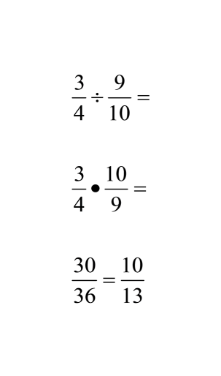
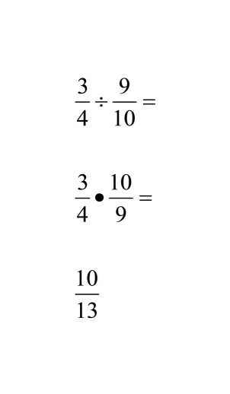
Sometimes you can cross simplify
prior to multiplying.
without cross
simplifying
with cross
simplifying
1
3

Slide 201
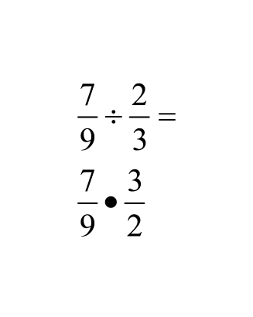
131
Can this problem be cross simplified?
Yes
No
Notes:
Answer: Yes

Slide 202
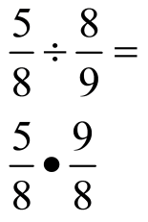
132
Can this problem be cross simplified?
Yes
No
Notes:
Answer: No

Slide 203
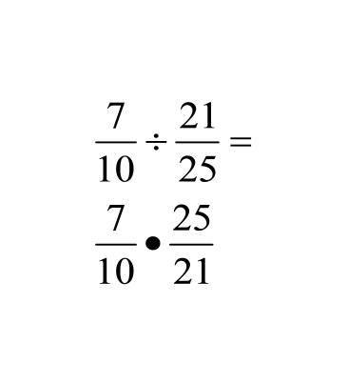
133
Can this problem be cross simplified?
Yes
No
Notes:
Answer: Yes

Slide 204
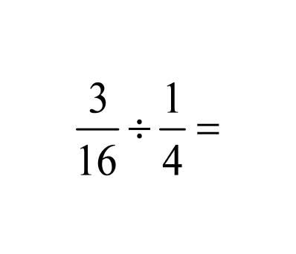
134
Notes:
Answer: 3/4

Slide 205
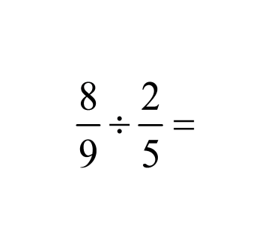
135
Notes:
Answer: 20/9 = 2 2/9

Slide 206
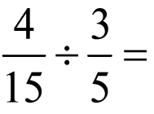
136
Notes:
Answer: 4/9

Slide 207
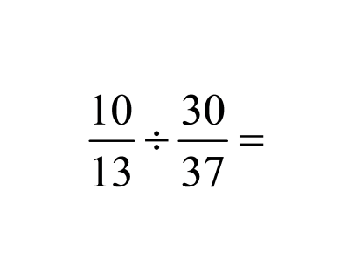
137
Notes:
Answer: 37/39

Slide 208
To divide fractions with whole or mixed numbers, write the numbers as an improper fractions. Then divide the two fractions by using the rule (multiply the first fraction by the reciprocal of the second).
Make sure you write your answer in simplest form.
1
2
3
3
1
2
5
3
7
2
5
3
2
7
10
21
=
=
x
=
6
1
1
2
6
1
3
2
61
2
3
12
3
=
=
x
=
=
4

Slide 209
138
1
1
2
2
2
3
=
Notes:
Answer: 9/16

Slide 210
139
2
1
2
÷
5
=
Notes:
Answer: 1/2

Slide 211
140
4
2
5
÷
5
1
4
=
Notes:
Answer: 16/35

Slide 212
141
3
1
2
2
3
8
÷
=
Notes:
Answer: 21/19 = 1 2/19

Slide 213
Application Problems - Examples
Winnie needs pieces of string for a craft project. How many 1/6 yd pieces of string can she cut from a piece that is 2/3 yd long?
2
3
÷
1
6
2
3
x
6
1
=
12
3
4
1
4 pieces
=
or
2
2
3
x
6
1
4
1
4 pieces
=
=
1

Slide 214
One student brings 1/2 yd of ribbon. If 3 students receive an equal length of the ribbon, how much ribbon will each student receive?
1
2
÷
3
1
2
x
1
3
=
1
6
yard of ribbon

Slide 215
Kristen is making a ladder and wants to cut ladder rungs from a 6 ft board. Each rung needs to be 3/4 ft long. How many ladder rungs can she cut?
3
4
6 ÷
6
1
3
4
÷
4
3
24
3
8
1
6
1
8 rungs
x
=
=
=

Slide 216
A box weighing 9 1/3 lb contains toy robots weighing 1 1/6 lb apiece. How many toy robots are in the box?
1
3
÷
1
6
9
1
28
3
7
6
÷
4
2
28
3
x
6
7
=
8
1
=
8 robots
1
1

Slide 217
142
Robert bought 3/4 pound of grapes and divided them into 6 equal portions. What is the weight of each portion?
A
8 pounds
B
4 1/2 pounds
C
2/5 pounds
D
1/8 pound
Notes:
Answer: D

Slide 218
143
A car travels 83 7/10 miles on 2 1/4, gallons of fuel. Which is the best estimate of the number miles the car travels on one gallon of fuel?
A
84 miles
B
62 miles
C
42 miles
D
38 miles
C
D
16 miles
Notes:
Answer: D

Slide 219
144
One tablespoon is equal to 1/16 cup. It is also equal to 1/2 ounce. A recipe uses 3/4 cup of flour. How many tablespoons of flour does the recipe use?
A
48 tablespoons
B
24 tablespoons
C
12 tablespoons
D
6 tablespoons
Notes:
Answer: C

Slide 220
145
A bookstore packs 6 books in a box. The total weight of the books is 14 2/5 pounds. If each book has the same weight, what is the weight of one book?
A
5/12 pound
B
2 2/5 pounds
C
8 2/5 pounds
D
86 2/5 pounds
Notes:
Answer: B

Slide 221
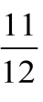

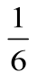
146
There is gallon of distilled water in the class
science supplies. If each pair of students doing an
experiment uses gallon of distilled water, there
will be gallon left in the supplies . How many
students are doing the experiments?
Notes:
Answer: 11/12 – 1/6 = 9/12 = ¾
¾ ÷ 1/16 = ¾ ∗ 16/1 = 7 students

Slide 222
Fraction Operations
Mixed Application
Return to
Table of
Contents

Slide 223
Now we will use the rules for adding, subtracting, multiplying and dividing fractions to solve problems.
Be sure to read carefully in order to determine what operation needs to be performed.
First, write the problem.
Next, solve it.

Slide 224
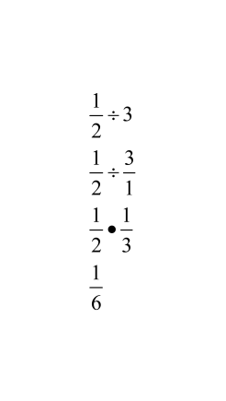
EXAMPLE:
How much chocolate will each person get if 3 people
share lb of chocolate equally?
1
2
x
1
6
Each person gets lb of chocolate.

Slide 225
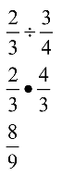
EXAMPLE
How many cup servings are in of a cup of yogurt?
3
4
2
3
x
8
9
There are servings.

Slide 226
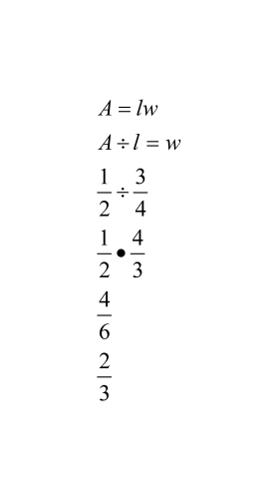
EXAMPLE:
How wide is a rectangular strip of land with length miles
and area square mile?
3
4
1
2
x
2
3
It is miles wide

Slide 227
147
One-third of the students at Finley High play sports. Two-fifths of the students who play sports are girls. Which expression can you evaluate to find the fraction of all students who are girls that play sports?
A
2/5 + 1/3
B
2/5 - 1/3
C
2/5 x 1/3
D
2/5 ÷ 1/3
Notes:
Answer: C

Slide 228
25
34
148
How many cup servings are in cups of milk?
You MUST write the problem and show ALL work!
Notes:
Answer: 1 7/8 servings

Slide 229
149
How much salt water taffy will each person get if
7 people share lbs?
56
You MUST write the problem and show ALL work!
Notes:
Answer: 5/42 pounds

Slide 230
45
150
If the area of a rectangle is square units and
its width is units, what is the length of the
rectangle?
13
You MUST write the problem and show ALL work!
Notes:
Answer: 2 2/5 units

Slide 231
34
151
A recipe calls for 1 cups of flour. If you want to
make of the recipe, how many cups of flour
should you use?
13
You MUST write the problem and show ALL work!
Notes:
Answer: 7/12 cup

Slide 232
35
152
Find the area of a rectangle whose width is
cm and length is cm.
27
You MUST write the problem and show ALL work!
Notes:
Answer: 6/35 cm²

Slide 233
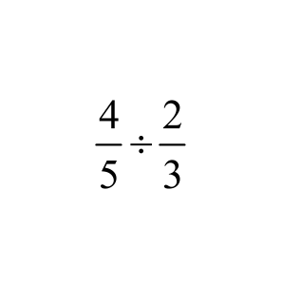
Working with a partner, write a question that can be solved using this expression:

