Slide 1
New Jersey Center for Teaching and Learning
Progressive Mathematics Initiative
This material is made freely available at www.njctl.org and is intended for the non-commercial use of students and teachers. These materials may not be used for any commercial purpose without the written permission of the owners. NJCTL maintains its website for the convenience of teachers who wish to make their work available to other teachers, participate in a virtual professional learning community, and/or provide access to course materials to parents, students and others.
Click to go to website:
www.njctl.org

Slide 2
6th Grade
Geometry
2012-10-17
www.njctl.org

Slide 3
Setting the PowerPoint View
Use Normal View for the Interactive Elements
To use the interactive elements in this presentation, do not select the Slide Show view. Instead, select Normal view and follow these steps to set the view as large as possible:
On the View menu, select Normal.
Close the Slides tab on the left.
In the upper right corner next to the Help button, click the ^ to minimize the ribbon at the top of the screen.
On the View menu, confirm that Ruler is deselected.
On the View tab, click Fit to Window.
Use Slide Show View to Administer Assessment Items
To administer the numbered assessment items in this presentation, use the Slide Show view. (See Slide 9 for an example.)

Slide 4
Table of Contents
Area of Rectangles
Area of Parallelograms
Area of Triangles
Area of Trapezoids
Mixed Review: Area
Click on a topic to
go to that section
Area of Irregular Figures
Area of Shaded Regions
3-Dimensional Solids
Surface Area
Volume
Polygons in the Coordinate Plane
Common Core: 6.G.1-4

Slide 5
Area of Rectangles
Return to
Table of
Contents

Slide 6
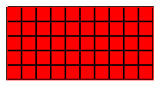
Area - The number of square units (units²) it takes to cover
the surface of a figure.
ALWAYS label units²!!!
10 ft
5 ft

Slide 7
How many 1 ft² tiles does it take to cover the rectangle?
Use the squares to find out!
Look for a faster way than covering the whole figure.
10 ft
5 ft

Slide 8
The Area (A) of a rectangle is found by using the formula:
A = length(width)
A = lw
The Area (A) of a square is found by using the formula:
A = side(side)
A = s²

Slide 9
1
What is the Area (A) of the figure?
13 ft
7 ft
Notes:
Answer:
A =lw, A =13(7), A = 91ft²

Slide 10
2
Find the area of the figure below.
8
Notes:
Answer:
A=s², A=8², A=64u²

Slide 11
3
Michelle needs new carpeting for her
bedroom that is 12 feet by 9 feet. Does
Michelle need to find the area or perimeter of
her bedroom in order to figure out how much
carpet to order?
A
Area
B
Perimeter
Notes:
Answer:
Since the carpeting will cover the floor in her room, it is area.

Slide 12
4
Now solve the problem....
Michelle needs new carpeting for her
bedroom that is 12 feet by 9 feet. How many
square feet of carpet does Michelle need to
order?
Notes:
Answer:
A=lw
A =12(9)
A=108 ft²

Slide 13
Area of Parallelograms
Return to
Table of
Contents

Slide 14
Area of a Parallelogram
Let's use the same process as we did for the rectangle. How
many 1 ft² tiles fit across the bottom of the parallelogram?

Slide 15
Area of a Parallelogram
Let's use the same process as we did for the rectangle. If we
build the parallelogram with rows of ten 1 ft² tiles, what
happens?
10 ft
How tall is the parallelogram?
How can you tell?

Slide 16
How does this help us find the area of the parallelogram?
4 ft
10 ft
How do you find the area of a parallelogram?
Notes:
Teacher Instructions: Green triangle can be moved.

Slide 17
The Area (A) of a parallelogram is found by using the formula:
Note: The base & height always form a right angle!
A = base(height)
A = bh

Slide 18
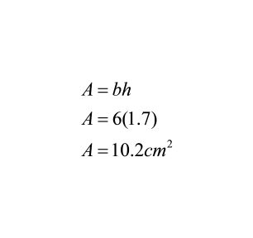
Example.
Find the area of the figure.
6 cm
2 cm
2 cm
1.7 cm
6 cm
click to reveal

Slide 19
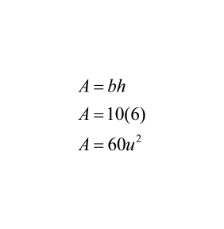
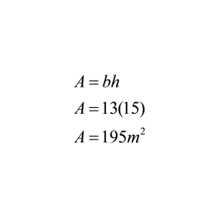
Try These.
Find the area of the figures.
13 m
10
16 m
15 m
6
8
13 m
click to reveal
click to reveal

Slide 20
5
Find the area.
10 ft
9 ft
11 ft
Notes:
Answer:
A=bh
A=11(9)
A=99ft²

Slide 21
6
Find the area.
15 in
11 in
10 in
11 in
15 in
Notes:
Answer:
A=bh
A=15(10)
A=150m²

Slide 22
7
Find the area.
8 m
13 m
13 m
12 m
8 m
Notes:
Answer:
A=bh
A=8 (12)
A=96m²

Slide 23
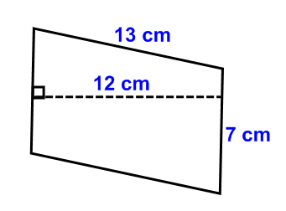
8
Find the area.
Notes:
Answer:
A=bh
A=12(7)
A=84cm²

Slide 24
Area of Triangles
Return to
Table of
Contents

Slide 25
Area of a Triangle
Let's use the same process as we did for the rectangle &
parallelogram. How many 1 ft² tiles fit across the bottom of the
triangle?

Slide 26
Area of a Triangle
If we continue to build the triangle with rows of
thirteen 1 ft² tiles what happens?
13 ft
How tall is the triangle? How can you tell?

Slide 27
How does this help us find the area of the triangle?
5 ft
13 ft
See that the rectangle we built is twice as large as the triangle. How do you find the area of a triangle?
Find the area of the rectangle, then divide by 2
32.5 ft2

Slide 28
Is this true for all triangles?
Let's see!
Calculating base(height) results in 2 triangles!

Slide 29
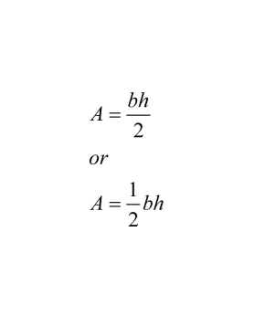
The Area (A) of a triangle is found by using the formula:
Note: The base & height always form a right angle!

Slide 30
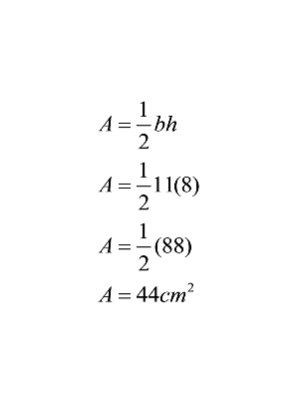
Example.
Find the area of the figure.
8 cm
click to reveal
click to reveal
11 cm
11 cm
11 cm

Slide 31
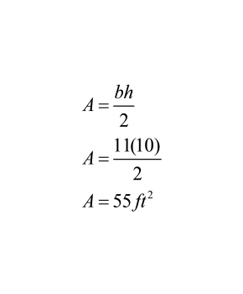
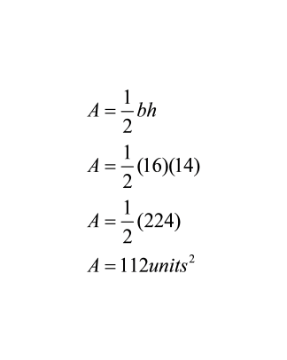
Try These.
Find the area of the figures.
20
13 ft
10 ft
12 ft
14
16
11 ft
16
click to reveal
click to reveal
click to reveal
click to reveal

Slide 32
9
Find the area.
10 in
9 in
8 in
6 in
Notes:
Answer:
A=¹/₂bh
A=¹/₂ (6)(9)
A=27in²

Slide 33
10
Find the area
10 m
12 m
9 m
14 m
Notes:
Answer:
A=¹/₂bh
A=¹/₂ (14)(9)
A=63m²

Slide 34
11
Find the area
7 cm.
8 cm.
10.5 cm
Notes:
Answer:
A=¹/₂bh
A=¹/₂ (7)(8)
A=28cm²

Slide 35
12
Find the area
10 in.
6 in.
5 in.
14 in.
Notes:
Answer:
A=¹/₂bh
A=¹/₂ (10)(5)
A=25in²

Slide 36
Area of Trapezoids
Return to
Table of
Contents

Slide 37
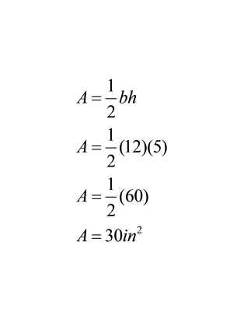
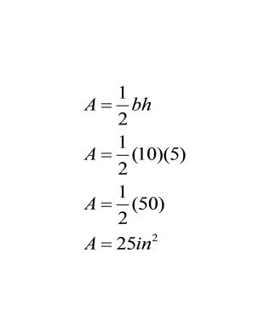
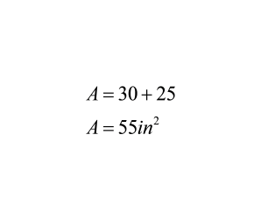
Area of a Trapezoid
Draw a diagonal line to break the trapezoid into two triangles.
Find the area of each triangle
Add the area of each triangle together
See the diagram below.
10 in
5 in
12 in

Slide 38
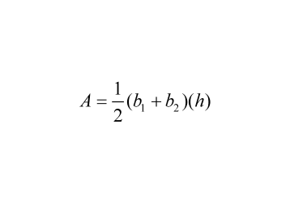
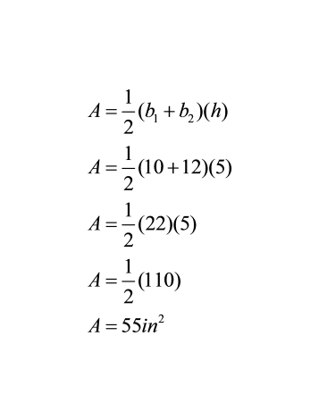
The Area (A) of a trapezoid is also found by using the formula:
Note: The base & height always form a right angle!
10 in
5 in
12 in

Slide 39
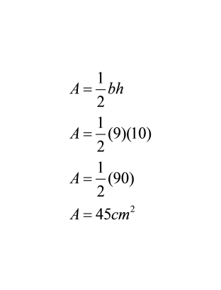
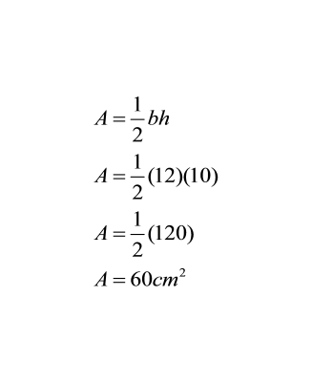
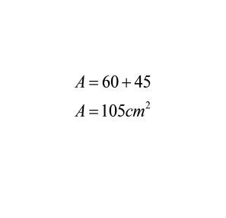
Example.
Find the area of the figure by drawing a diagonal and splitting it into two triangles.
12 cm
10 cm
11 cm
9 cm
12 cm
click to reveal
10 cm
11 cm
9 cm

Slide 40
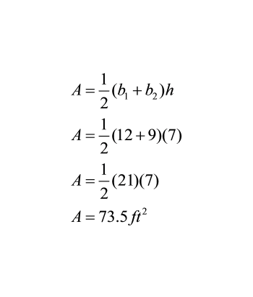
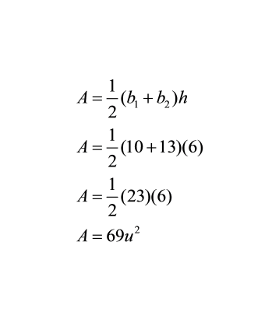
Try These.
Find the area of the figures using the formula.
12 ft
10
8 ft
7 ft
8 ft
7
6
8
9 ft
13
click to reveal
click to reveal

Slide 41
13
Find the area of the trapezoid by drawing a diagonal.
9 m
8.5 m
11 m
Notes:
Answer:
A=¹/₂bh A=¹/₂bh
A=¹/₂ (11)(8.5) A=¹/₂ (9)(8.5)
A=¹/₂ (93.5) A=¹/₂ (76.5)
A=46.75m² A=38.25m²
A=46.75+38.25
A=85m²

Slide 42
14
Find the area of the trapezoid using the formula.
20 cm
12 cm
13 cm
Notes:
Answer:
A=¹/₂(b₁+b₂)h
A=¹/₂ (20+13)(12)
A=¹/₂ (33)(12)
A=198cm²

Slide 43
Mixed Review:
Area
Return to
Table of
Contents

Slide 44
15
Find the area of the figure.
5 cm
4 cm
3 cm
4 cm
11 cm
Notes:
Answer:
A=¹/₂(b₁+b₂)h
A=¹/₂ (5+11)(3)
A=¹/₂ (16)(3)
A=24cm²

Slide 45
16
Find the area of the figure.
10.5 yd
10.5 yd
8 yd
10.5 yd
Notes:
Answer:
A=¹/₂bh
A=¹/₂ (10.5)(8)
A=42 yd²

Slide 46
17
Find the area of the figure.
4.7 m
7.2 m
Notes:
Answer:
A = lw
A = 7.2(4.7)
A = 33.84m²

Slide 47
18
Find the area of the figure.
9 in
7 in
15 in
Notes:
Answer:
A=bh
A=15(7)
A=105 in²

Slide 48
19
Find the area of the figure by drawing a diagonal
and creating triangles.
17 cm
16 cm
15 cm
16 cm
22 cm
Notes:
Answer:
A=¹/₂bh A=¹/₂bh
A=¹/₂ (17)(15) A=¹/₂ (22)(15)
A=127.5 cm² A=165 cm²
A=127.5+165
A=292.5 cm²

Slide 49
20
Find the area of the figure.
7 in
5.2 in
12.4 in
Notes:
Answer:
A=bh
A=12.4(5.2)
A=64.48 in²

Slide 50
21
Find the area of the figure.
12 yd
12 yd
11 yd
13 yd
Notes:
Answer:
A=¹/₂bh
A=¹/₂ (13)(11)
A=71.5 yd²

Slide 51
22
Find the area of the figure.
4.6 m
8.7 m
Notes:
Answer:
A=lw
A=8.7 (4.6)
A=40.02 m²

Slide 52
23
A wall is 56" wide. You want to center a picture
frame that is 20" wide on the wall. How much
space will there be between the edge of the wall
and the frame?
Notes:
Answer:
18 inches on each side

Slide 53
24
Daniel decided to walk the perimeter of his
triangular backyard. He walked 26.2 feet north and
19.5 feet west and back to his starting point. What
is the area of Daniel's backyard?
Notes:
Answer:
A=¹/₂bh
A=¹/₂ (26.2)(19.5)
A=255.45 ft²

Slide 55
Area of
Irregular Figures
Return to
Table of
Contents

Slide 56
Area of Irregular Figures
Method #1
1. Divide the figure into smaller figures
(that you know how to find the area of)
2. Label each small figure and label the new lengths and
widths of each shape
3. Find the area of each shape
4. Add the areas
5. Label your answer

Slide 57
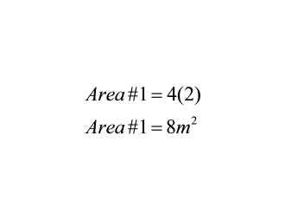
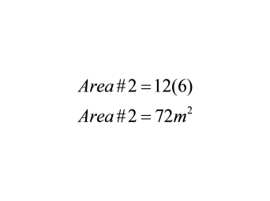
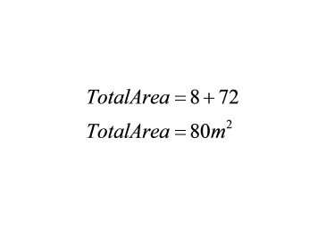
Example:
Find the area of the figure.
4 m
2 m
8 m
12 m
4 m
2 m
#1
2 m
#2
6 m
12 m

Slide 58
Area of Irregular Figures
Method #2
1. Create one large, closed figure
2. Label the small added figure and label the new lengths
and widths of each shape
3. Find the area of the new, large figure
4. Subtract the areas
5. Label your answer

Slide 59
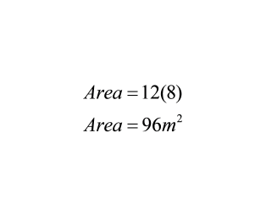
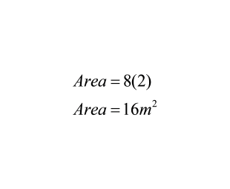
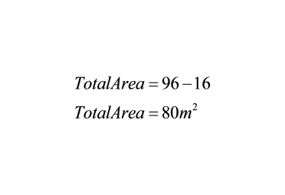
Example:
Find the area of the figure.
4 m
2 m
8 m
12 m
8 m
4 m
Whole Rectangle
Extra Rectangle
2 m
8 m
12 m

Slide 60
Try These:
Find the area of each figure.
6 ft
3m
5m
18 ft
3m
10 ft
8m
12 ft
Notes:
Answer:
Left figure:
Whole Square Extra Square
Area = 8(8) Area = 5(5)
Area = 64m² Area = 25m²
Total Area = 60 - 25
Total Area = 35m²
Right figure:
Whole Triangle Bottom Trapezoid
Area = 1/2(18)(6) Area = 1/2(12+18)(10)
Area = 54ft² Area = 1/2(30)(10)
Area = 150 ft²
Total Area = 54 + 150
Total Area = 204 ft²

Slide 61
25
Find the area.
4'
3'
1'
10'
5'
2'
8'
Notes:
Answer:
Top Rectangle: Vertical Rectangle:
A=4(3) A=(5)(1)
A=12 ft² A=5 ft²
Bottom Rectangle:
A=(2)(8)
A=16 ft²
Total Area:
A=12+16+5
A=33 ft²

Slide 62
26
Find the area.
12
10
20
13
10
25
Notes:
Answer:
Whole New Figure: New Rectangle:
A = 25(20) A = 10(13)
A = 500 u² A = 130 u²
Total Area:
A = 500 - 130
A = 370 u²

Slide 63
27
Find the area.
8 cm
18 cm
9 cm
Notes:
Answer:
Triangle: Rectangle:
A = 1/2(9)(8) A = (18)(9)
A = 36 cm² A = 162 cm²
Total Area:
A = 36 + 162
A = 198 cm²

Slide 64
Find the area.
28
6 ft
7 ft
9 ft
4 ft
Notes:
Answer:
Triangle: Trapezoid:
A = 1/2bh A = 1/2(b₁+b₂)h
A = 1/2(7)(4) A = 1/2(6+9)(7)
A = 14 ft² A = 52.5 ft²
A = 36 ft²
Total Area:
A = 36 + 52.5
A = 88.5 ft²

Slide 65
29
Find the area.
14 mm
8 mm
8 mm
10 mm
8 mm
14 mm
6 mm
Notes:
Answer:
Area of Triangle 1: Area of Triangle 2:
A = 1/2bh A = 30 mm²
A = 1/2(10)(6)
A = 30 mm²
Area of Rectangle:
A = lw
A = (10)(14)
A = 140 mm²
Total Area:
A = 33 + 33 + 140
A = 206 mm²

Slide 66
Area of
Shaded Regions
Return to
Table of
Contents

Slide 67
Area of a Shaded Region
1. Find area of whole figure.
2. Find area of unshaded figure(s).
3. Subtract unshaded area from whole figure.
4. Label answer with units².

Slide 68
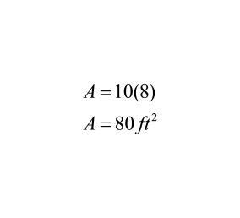
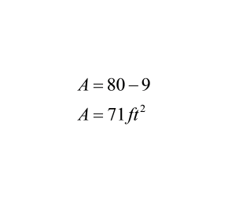
Example
Find the area of the shaded region.
×
Area Whole Rectangle
10 ft
3 ft
8 ft
3 ft
Area Unshaded Square
Area Shaded Region

Slide 69
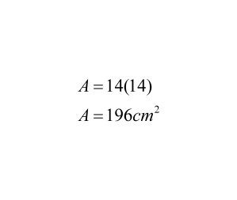
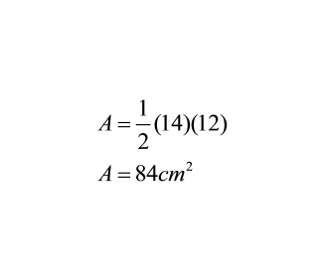
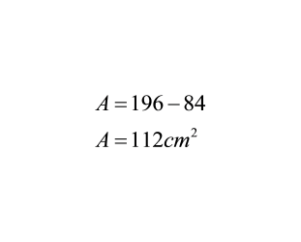
Try This
Find the area of the shaded region.
×
Area Whole Square
Area Triangle
12 cm
14 cm
Area Shaded Region

Slide 70
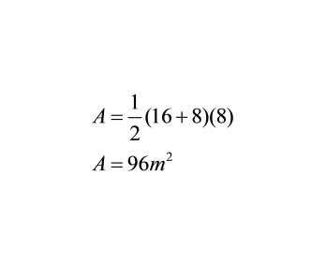
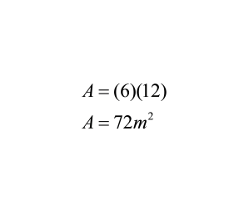
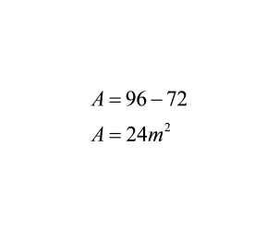
×
Try This
Find the area of the shaded region.
Area Trapezoid
16 m
6 m
12 m
Area Rectangle
2 m
8 m
Area Shaded Region

Slide 71
30
Find the area of the shaded region.
11'
3'
4'
8'
Notes:
Answer:
Area Whole Rectangle:
A = (11)(8)
A = 88 ft²
Area Unshaded:
A = (3)(4)
A = 12 ft²
Area Shaded Region:
A = 88 - 12
A = 76 ft²

Slide 72
31
Find the area of the shaded region.
16"
7"
15"
5"
17"
Notes:
Answer:
Area Parallelogram:
A = (17)(15)
A = 255 in²
Area of Triangle:
A = 1/2(7)(5)
A = 17.5 in²
Area Shaded Region:
A = 255 - 17.5
A = 237.5 in²

Slide 73
32
Find the area of the shaded region.
8"
14"
9"
4"
5"
13"
Notes:
Answer:
Area Whole:
A = (14)(8)+(5)(5)
A = 112+25
A = 137 in²
Area Rectangle:
A = (9)(4)
A = 36 in²
Area Shaded Region:
A = 137-36
A = 101 in²

Slide 74
33
Find the area of the shaded region.
4 yd
4 yd
3 yd
4 yd
8 yd
Notes:
Answer:
Area Rectangle:
A = (12)(7)
A = 84 yd²
Area of Triangle:
A = 1/2(4)(4)
A = 8 yd²
Area of Triangle:
A = 8 yd²
Area Shaded Region:
A = 50.24 - 8
A = 42.24 yd²

Slide 75
34
A cement path 2 feet wide is poured around a rectangular pool. If the pool is 13 feet by 9 feet,
how much cement was needed to create the path?
Notes:
Answer:
Area Path & Pool:
A = (17)(13)
A = 211 ft²
Area Pool:
A = (13)(9)
A = 117 ft²
Area Path:
A = 221 - 117
A = 104 ft²

Slide 76
3-Dimensional Solids
Return to
Table of
Contents

Slide 77
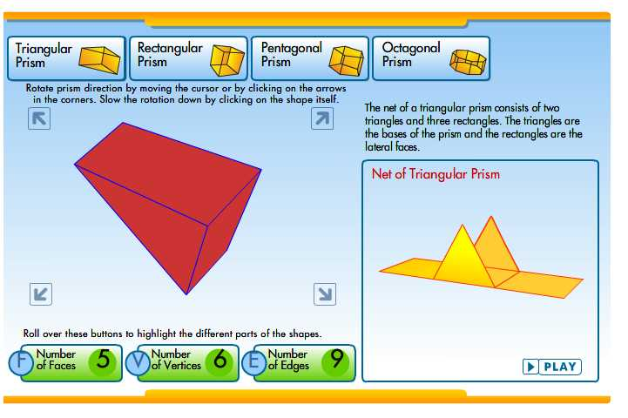
Click for a web site with interactive
3-D figures and nets.

Slide 78
3-Dimensional Solids
Categories & Characteristics of 3-D Solids:
Prisms
1. Have 2 congruent, polygon bases which are parallel
to one another
2. Sides are rectangular (parallelograms)
3. Named by the shape of their base
click to reveal
Pyramids
1. Have 1 polygon base with a vertex opposite it
2. Sides are triangular
3. Named by the shape of their base
click to reveal
click to reveal

Slide 79
3-Dimensional Solids
Categories & Characteristics of 3-D Solids:
Cylinders
1. Have 2 congruent, circular bases which
are parallel to one another
2. Sides are curved
click to reveal
Cones
1. Have 1 circular bases with a vertex opposite it
2. Sides are curved
click to reveal

Slide 80
3-Dimensional Solids
Vocabulary Words for 3-D Solids:
×
Polyhedron A 3-D figure whose faces are all polygons
(Prisms & Pyramids)
Face Flat surface of a Polyhedron
Edge Line segment formed where 2 faces meet
Vertex (Vertices) Point where 3 or more faces/edges meet
Solid a 3-D figure
Net a 2-D drawing of a 3-D figure
(what a 3-D figure would look like if it were unfolded)

Slide 81
35
Name the figure.
A
rectangular prism
B
triangular prism
C
triangular pyramid
D
cylinder
E
cone
F
square pyramid
Notes:
Answer: C

Slide 82
36
Name the figure.
rectangular prism
A
triangular prism
B
triangular pyramid
C
D
cylinder
E
cone
square pyramid
F
Notes:
Answer: A

Slide 83
37
Name the figure.
rectangular prism
A
triangular prism
B
triangular pyramid
C
pentagonal prism
D
cone
E
square pyramid
F
Notes:
Answer: D

Slide 84
38
Name the figure.
A
rectangular prism
B
triangular prism
C
triangular pyramid
D
pentagonal prism
E
cone
F
square pyramid
Notes:
Answer: E

Slide 85
39
Name the figure.
A
rectangular prism
B
cylinder
C
triangular pyramid
D
pentagonal prism
E
cone
F
square pyramid
Notes:
Answer: B

Slide 86
40
Name the figure represented by the net.
A
rectangular prism
B
cylinder
C
triangular prism
D
pentagonal prism
E
cone
F
square pyramid
Notes:
Answer: C

Slide 87
41
Name the figure represented by the net.
A
rectangular prism
B
cylinder
C
triangular prism
D
pentagonal prism
E
cone
F
square pyramid
Notes:
Answer: F

Slide 88
For each figure, find the number of faces, vertices and edges.
Can you figure out a relationship between the number of faces, vertices and edges of 3-Dimensional Figures?
Name | Faces | Vertices | Edges
Cube | 6 | 8 | 12
Rectangular Prism | 6 | 8 | 12
Triangular Prism | 5 | 6 | 9
Triangular Pyramid | 4 | 4 | 6
Square Pyramid | 5 | 5 | 8
Pentagonal Pyramid | 6 | 6 | 10
Octagonal Prism | 10 | 16 | 24

Slide 89
Euler's Formula
F + V - 2 = E
The number of edges is 2 less than
the sum of the faces and vertices.
click to reveal

Slide 90
42
How many faces does a cube have?
Notes:
Answer: 6

Slide 91
43
How many vertices does a triangular prism have?
Notes:
Answer: 6

Slide 92
44
How many edges does a square pyramid have?
Notes:
Answer: 8

Slide 93
Surface Area
Return to
Table of
Contents

Slide 94
Surface Area
The sum of the areas of all outside faces of a 3-D figure.
To find surface area, you must find the area of each face of the
figure then add them together.
What type of figure is pictured?
How many surfaces are there?
How do you find the area of each
surface?
6 in
2 in
7 in

Slide 95
Surface Area
6 in
#1
6 in
#2
#3
#4
2 in
2 in
6 in
#5
7 in
#6
2 in
A net is helpful in calculating surface area.
Simply label each section and find the area of each.
7 in

Slide 96
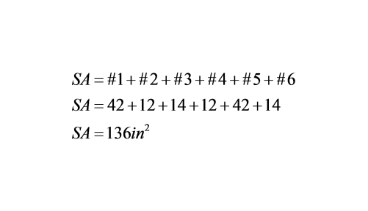
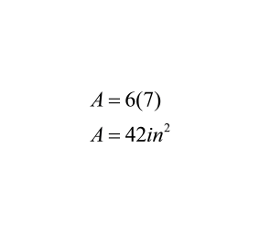
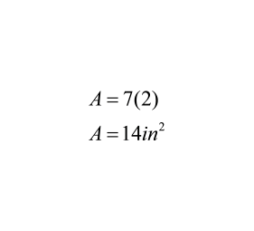
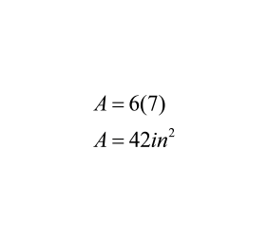
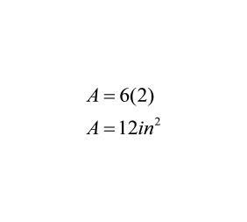
Example
#1
6 in
#2
#3
#4
2 in
6 in
#5
#6
2 in
7 in
#1
#2
#3
#4
#5
#6

Slide 97
Try This
Find the surface area of figure using
the given net.
#1
12 cm
#2
#3
#4
15 cm
#5
Notes:
Answer:
SA = #1+#2+#3+#4+#5
SA = 90+90+112.5+90+90
SA = 472.5 cm²
#1 #2 #3
A = 1/2(15)(12) A = 1/2(15)(12) A = 1/2(15)(15)
A = 90 cm² A = 90 cm² A = 112.5 cm²
#4 #5
A = 1/2(15)(12) A = 1/2(15)(12)
A = 90 cm² A = 90 cm²

Slide 98
45
Find the surface area of the figure given its net.
7 yd
7 yd
7 yd
7 yd
Since all of the faces are the same, you can find the area of one face and multiply it by 6 to calculate the surface area of a cube.
What pattern did you notice while finding the surface area
of a cube?
Notes:
Answer:
SA = #1+#2+#3+#4+#5
SA = 49+49+49+49+49+49
SA = 294 yd²
#1-#6
A = 7(7)
A = 49 yd²

Slide 99
46
Find the surface area of the figure given its net.
12 cm
9 cm
25 cm
Notes:
Answer:
SA = #1+#2+#3+#4+#5
SA = 300+54+300+54+300
SA = 1008 cm²
#1 #2 #3
A = 12(25) A = 1/2(12)(9) A = 12(25)
A = 300 cm² A = 54 cm² A = 300 cm²
#4 #5
A = 1/2(12)(9) A = 12(25)
A = 54 cm² A = 300 cm²

Slide 100
The figure below represents a present you want
to wrap for your friend's birthday. How many
square centimeters of wrapping paper will you
need? Draw the net for the given figure and
calculate its surface area.
47
10 cm
10 cm
18 cm
Notes:
Answer:
SA=#1+#2+#3+#4+#5+#6
SA= 180+100+180+100+180+180
SA=920cm²
#1, #3, #5, #6 #2, #4
A=10(18) A=10(10)
A=180cm² A=100cm²

Slide 101
48
Draw the net for the given figure and calculate its surface area.
12 ft
11 ft
4 ft
7 ft
7 ft
Notes:
Answer:
SA = #1+#2+#3+#4
SA = 66+42+22+42
SA = 172 ft²
#1 #2 #3 #4
A = 1/2(11)(12) A = 1/2(7)(12) A = 1/2(11)(4) A = 1/2(7)(12)
A = 66 ft² A = 42 ft² A = 22 ft² A = 42 ft²

Slide 102
Volume
Return to
Table of
Contents

Slide 103
Volume Activity
Take unit cubes and create a rectangular prism with dimensions of 4 x 2 x 1.
What happens to the volume if you add another layer and make it 4 x 2 x 2?
What happens to the volume is you add another layer and make it 4 x 2 x 3?
Notes:
Teacher Instructions: Lead students to discover that the area of the base times the height equals the volume.

Slide 104
Volume
Volume
- The amount of space occupied by or inside a 3-D Figure
- The number of cubic units needed to FILL a 3-D Figure (layering)
Label
Units³ or cubic units
click to reveal
click to reveal

Slide 105
Volume Formulas
Formula 1
V= lwh, where l = length, w = width, h = height
Multiply the length, width, and height of the rectangular prism.
Formula 2
V=Bh, where B = area of base, h = height
Find the area of the rectangular prism's base and multiply it by the
height.

Slide 106
Find the Volume.
8 m
2 m
5 m
Notes:
Answer:
Volume Volume
2 V = B × h
5 V = l × w × h
10 (Area of Base) V = 5 × 2 × 8
8 (Height) V = 10 × 8
80 m³ V = 80 m³

Slide 107
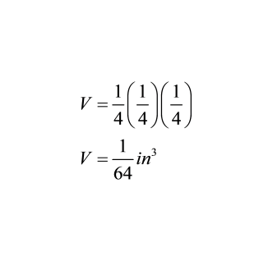
Example
Each of the small cubes in the prism shown have a length, width and height of 1/4 inch.
The formula for volume is lwh.
Therefore the volume of one of the small
cubes is:
Multiply the numerators together, then multiply the denominators. In other words, multiply across.
Forget how to multiply fractions?

Slide 108
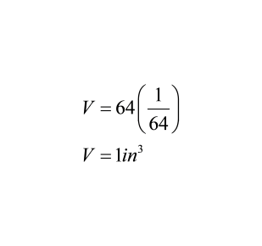
Example
To calculate the volume of the whole prism, count the number of cubes, and multiply it by the volume of one cube.
The top layer of this prism has 4 rows of 4 cubes, making a total of 16 cubes per layer.
The prism has 4 layers, 16 cubes per layer, so has 64 small cubes total.
Therefore the total volume of the prism is:

Slide 109
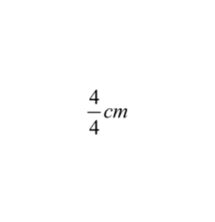
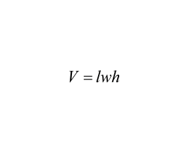
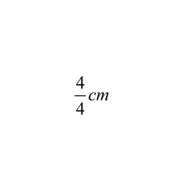
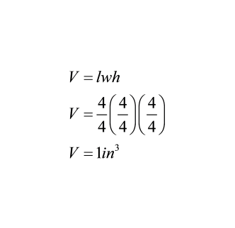
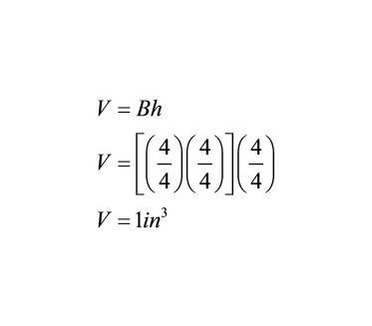
Example
You can also use the formula to find the volume of the same prism.
The length, width, and the height of this prism is four small cubes.
Remember each small cube has a length, width, and height of 1/4 inch.
Therefore, you can find the total volume finding the total length, width, and height of the prism and multiplying them together.

Slide 110
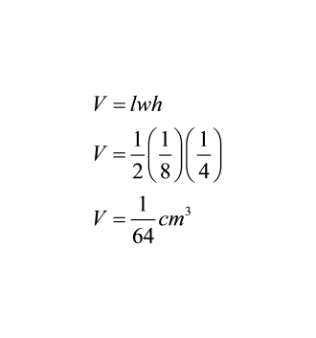
Example
How would you find the volume
of the rectangular prism with
side lengths of 1/2 cm, 1/8 cm,
and 1/4 cm?
Since it already tells you the side lengths, you can simply plug it into the volume formula.
Click to Reveal

Slide 111
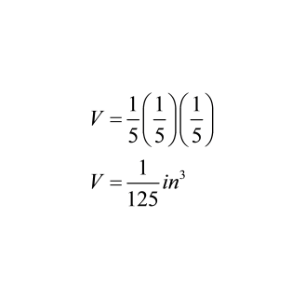
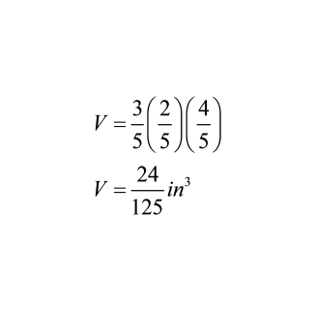
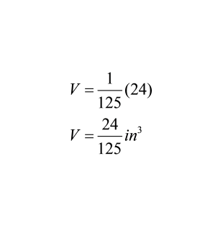
Try This
Every cube in the rectangular prism has a length, width and height of 1/5 inch.
Find the total volume of the rectangular prism.
Method 1: Find volume of one small cube and multiply it by the number of cubes.
One cube: Total Volume:
Method 2: Find the length, width, and height of the rectangular prism and use the formula.
Click to Reveal
Click to Reveal

Slide 112
49
Find the volume of the given figure.
Notes:
Answer:
V = lwh
V = 2/5 (5/8)(2/3)
V = 20/120 yd³
V = 1/6 yd³

Slide 113
50
Find the volume of the given figure.
Notes:
Answer:
V = lwh
V = 5/4 (1/2)(2/3)
V = 10/24 mm³
V = 5/12 mm³

Slide 114
Find the volume of the given figure.
51
Notes:
Answer:
V = Bh
V = [(3/5)(7/9)](7/4)
V = [(21/45)](7/4)
V = 147/180 m³

Slide 115
52
Find the volume of the given figure.
The length, width, and height of one small cube is
.
Notes:
Answer:
Method 1
Vcube = (2/7)(2/7)(2/7)
Vcube = 8/343 cm³
V = 8/343(18)
V= 144/343 cm³
Method 2
V =Bh
V = [(6/7)(4/7)](6/7)
V =144/343 cm³

Slide 116
53
Find the volume of the given figure.
The length, width, and height of one cube is .
Notes:
Answer:
Method 1
Vcube = 3/8(3/8)(3/8)
Vcube = 27/512 in³
V = 27/512(30)
V = 810/512 in³
V = 2 149/256 in³
Method 2
V =lhw
V =9/8(6/8)(15/8)
V =810/512 in³
V =1 149/256 in³

Slide 117
Polygons in the Coordinate Plane
Return to
Table of
Contents

Slide 118
A few pages of review from the Number System Unit...

Slide 119
REVIEW
0
The coordinate plane is divided into four sections called quadrants.
Each quadrant is numbered using the Roman numerals I through IV, in a counter-clock wise direction.

Slide 120
c
REVIEW
Slide the "C"
onto the
coordinate plane
0
The Coordinate plane is also called the Cartesian plane.
One way to remember how the quadrants are numbered is to write a big "C" on top of the plane. The "C" will begin in quadrant I and end in quadrant IV.

Slide 121
REVIEW
y - axis
0
x - axis
The quadrants are formed by two intersecting number lines called axes.
The horizontal line is the x-axis.
The vertical line is the y-axis.

Slide 122
REVIEW
Origin
(0, 0)
0
The point at which the x and y axes intersect is called the origin. The coordinates of the origin are (0, 0).

Slide 123
REVIEW
0
Points can be plotted on the plane using one coordinate from each of the axes.
These sets are called ordered pairs. The x coordinate always appears first in these pairs. The y coordinate appears second.
(x, y)

Slide 124
Each of the quadrants can be identified by the properties of the numbers that fall within their plane. Remember the ordered pairs are always of the form (x, y)
REVIEW
(-,+)
( +,+)
0
(-,-)
(+,-)

Slide 125
Study the table below. What pattern do you see between the set of points and the distance between them?
Is there a way to find the distance between the two points without graphing them first on a coordinate plane?
REVIEW
Points | Distance
(-6, 2) (3, 2) | 9
(-5, 4) (1, 4) | 6
(-2, 6) (-2, -4) | 10
(-5, 7) (-5, 3) | 4
(3, -3) (8, -3) | 5

Slide 126
If two points have either the same x- or y-coordinate, the distance between them can be as follows:
If the different coordinates are either both positive or both negative, subtract their absolute values.
If the different coordinates are opposite signs, add their absolute values.
Let's look at the table again to see how this works:
Points | Distance
(-6, 2) (3, 2) | |-6| + |3| = 6 + 3 = 9
(-5, 4) (1, 4) | |-5| + |1| = 5 + 1 = 6
(-2, 6) (-2, -4) | |6| + |-4| = 6 + 4 = 10
REVIEW
(-5, 7) (-5, 3) | |7 - 3| = |4| = 4
(3, -3) (8, -3) | |3 - 8| = |-5| = 5

Slide 127
Example
Plot the following points and connect them in the order given. Use the coordinates to find the length of each side.
A (4,2) B (-2, 2) C (-2, -2) D (4, -2)
Click to Reveal
6 units
B
A
4 units
4 units
C
D
6 units

Slide 128
Example
Plot the following points and connect them in the order given. What is the coordinate of a fourth point that would create a rectangle?
W (5,6) X (-6, 6) Y (-6, 0)
Click to Reveal
X
W
Y
Z
(5,0)

Slide 129
Try This
Plot the following points and connect them in the order given. Use the coordinates to find the length of side CD.
A (6,8) B (-3, 8) C (-3, -1) D (6, -1)
Click to Reveal
C (-3, -1)
D (6, -1)
|-3| + |6| = 9 units
CD = 9 units

Slide 130
Try This
Plot the following points and connect them in the order given. What is the coordinate of a fourth point that would create a square?
J (1,8) K (6, 8) L (1, 3)
Click to Reveal
J
K
L
M
(6,3)

Slide 131
Plot the following points and connect them in the order given. What is the coordinate of the fourth point that creates a parallelogram?
Q (4, 4) R (0,4) S (-1,1)
54
A
(4,1)
B
(5,1)
C
(2,1)
D
(3,1)
Notes:
Answer: D

Slide 132
Plot the following points and connect them in the order given. What is the length of AD?
A (-1, -2) B (-5, -2) C(-2, -4) D(-1, -4)
55
Notes:
Answer: 2 units

Slide 133
Plot the following points and connect them in the order given. What would be the coordinates of a third point that would form a right isosceles triangle?
E (2, 2) F (2, -2)
56
A
(-2, -2)
B
(4, 0)
C
(-1, 0)
D
(5, -2)
Notes:
Answer: A

Slide 134
Without plotting the points given, find the perimeter of the shape given its coordinates.
S (5, -5) T (1, -5) U (1, 3) V (5, 3)
57
Notes:
Answer: 24 units

Slide 135
Without plotting the points given, find the area of the shape given its coordinates.
L (-1, 1) M (-1, -5) N (4, -5) O (4, 1)
58
Notes:
Answer: 30 u²

