Slide 1
New Jersey Center for Teaching and Learning
Progressive Mathematics Initiative
This material is made freely available at www.njctl.org and is intended for the non-commercial use of students and teachers. These materials may not be used for any commercial purpose without the written permission of the owners. NJCTL maintains its website for the convenience of teachers who wish to make their work available to other teachers, participate in a virtual professional learning community, and/or provide access to course materials to parents, students and others.
Click to go to website:
www.njctl.org

Slide 2
6th Grade
Number System
2012-08-08
www.njctl.org

Slide 3
Setting the PowerPoint View
Use Normal View for the Interactive Elements
To use the interactive elements in this presentation, do not select the Slide Show view. Instead, select Normal view and follow these steps to set the view as large as possible:
On the View menu, select Normal.
Close the Slides tab on the left.
In the upper right corner next to the Help button, click the ^ to minimize the ribbon at the top of the screen.
On the View menu, confirm that Ruler is deselected.
On the View tab, click Fit to Window.
Use Slide Show View to Administer Assessment Items
To administer the numbered assessment items in this presentation, use the Slide Show view. (See Slide 6 for an example.)

Slide 4
Number System
Unit Topics
Opposites
Click on the topic to go to that section
Absolute Value
Comparing Integers
Comparing and Ordering Rational Numbers
Cartesian Plane
Graphing Ordered Pairs
Cartesian Plane Applications
Common Core Standards: 6.NS.5, 6.NS.6, 6.NS.7, 6.NS.8

Slide 5
Opposites
Return to
Table of
Contents

Slide 6
1
Do you know what an integer is?
Yes
No

Slide 7
Define Integer
Definition of Integer:
The set of natural numbers, their opposites, and zero.
Examples of Integers:
{...-6, -5, -4, -3, -2, -1, 0, 1, 2, 3, 4, 5, 6, 7...}

Slide 8
Integers on the number line
Negative
Integers
Positive
Integers
Zero
-5
-4
-3
-2
-1
0
1
2
3
4
5
Numbers to the left of zero are less than zero
Numbers to the right of zero are greater than zero
Zero is neither
positive or negative
`

Slide 9
Classify each number as an integer, or not.
5
-6
-21
-65
1
3.2
0
-6.32
2.34437 x 10³
½
3¾
9
¾
π
5
integer
not an integer

Slide 10
2
Which of the following are examples of integers?
A
0
B
-8
C
-4.5
D
7
E
1
3
Notes:
Answer: A, B, D

Slide 11
3
Which of the following are examples of integers?
A
1
4
B
6
C
-4
D
0.75
E
25%
Notes:
Answer: B, C

Slide 12
Integers In Our World

Slide 13
Integers can represent
everyday situations
You might hear "And the quarterback is sacked for a loss of 7 yards."
This can be represented as an integer: -7
Or, "The total snow fall this year has been 9 inches more than normal."
This can be represented as in integer: +9 or 9

Slide 14
Write an integer to represent
each situation:
Answer
1. Spending $6
2. Gain of 11 pounds
3. Depositing $700
4. 10 degrees below zero
5. 8 strokes under par (par = 0)
6. 350 feet above sea level
-$6
Answer
11 lbs.
Answer
$700
-10 degrees
Answer
-8
Answer
350 ft
Answer

Slide 15
4
Which of the following integers best represents the following scenario:
The effect on your wallet when you spend 10 dollars.
A
-10
B
10
C
0
D
+/- 10
Notes:
Answer: A

Slide 16
5
Which of the following integers best represents the following scenario:
Earning $40 shoveling snow.
A
-40
B
40
C
0
D
+/- 40
Notes:
Answer: B

Slide 17
6
Which of the following integers best represents the following scenario:
You dive 35 feet to explore a sunken ship.
A
-35
B
35
C
0
D
+/- 35
Notes:
Answer: A

Slide 18
The numbers -4 and 4 are shown on the number line.
-10
-9
-8
8
9
10
-7
-6
-5
-4
-3
-2
-1
0
1
2
3
4
5
6
7
Both numbers are 4 units from 0,
but 4 is to the right of 0 and -4 is to the left of zero.
The numbers -4 and 4 are opposites.
Opposites are the same distance from zero.

Slide 19
There are 2 ways to read: -9
"negative nine"
"the opposite of nine"
So, saying "negative" and "the opposite of" are inter-changeable.
Remember, opposites are the same distance from zero, just on different sides of the number line.

Slide 20
7
What is the opposite of -5?
Notes:
Answer: 5

Slide 21
8
What is the opposite of 25?
Notes:
Answer: -25

Slide 22
9
What is the opposite of 0?
Notes:
Answer: 0

Slide 23
10
What is the opposite of 18?
Notes:
Answer: -18

Slide 24
11
What is the opposite of -18?
Notes:
Answer: 18

Slide 25
12
What is the opposite of the opposite -18?
Notes:
Answer: -18

Slide 26
What conclusions can you draw about the opposite of the opposite of a number?
It's the same as the original number!
Let's look at the last three problems.
18
Opposite of 18 = -18
Opposite of the opposite of 18 = -(-18) = 18
This will be helpful to understand when we work with integer operations!

Slide 27
13
Simplify: - (- 9)
Notes:
Answer: 9

Slide 28
14
Simplify: - (- 12)
Notes:
Answer: 12

Slide 29
15
Simplify: - [- (-15)]
Notes:
Answer: -15

Slide 30
Integers are used in game shows.
In the game of Jeopardy you:
earn points for a correct response
lose points for an incorrect response
can have a positive or negative score

Slide 31
When a contestant gets a $200 question correct:
Score = $200
Then a $100 question incorrect:
Score = $100
Then a $300 question incorrect:
Score = - $200
How did the score become negative?
1. $0 + $200 = $200
2. $200 - $100 = $100
3. $100 - $300 = -$200
Click for Answer

Slide 32
16
After the following 3 responses what would the contestants score be?
$100 incorrect
$200 correct
$50 incorrect
Notes:
Answer: $0 - $100 = -$100
-$100 + $200 = $100
$100 - $50 = $50

Slide 33
17
After the following 3 responses what would the contestants score be?
$200 correct
$50 correct
$300 incorrect
Notes:
Answer: $0 +$200 = $200
$200 + $50 = $250
$250 - $300 = -$50

Slide 34
18
After the following 3 responses what would the contestants score be?
$150 incorrect
$50 correct
$100 correct
Notes:
Answer: $0 - $150 = -$150
-$150 + $50 = -$100
-$100 + $100 = $0

Slide 35
To Review
An integer is zero, any natural number, or its opposite.
Number lines have negative numbers to the left of zero and positive numbers to the right.
Zero is neither positive nor negative.
Integers can be used to represent real life situations.

Slide 36
Absolute Value
Return to
Table Of
Contents

Slide 37
Absolute Value of Integers
The absolute value is the distance a number is from zero on the number line, regardless of direction.
Distance and absolute value are always non-negative (positive or zero).
-10
-9
-8
-7
-6
-5
-4
-3
-2
-1
0
1
2
3
4
5
6
7
8
9
10
What is the distance from 0 to 5?

Slide 38
Absolute Value of Integers
The absolute value is the distance a number is from zero on the number line, regardless of direction.
Distance and absolute value are always non-negative.
-10
-9
-8
-7
-6
-5
-4
-3
-2
-1
0
1
2
3
4
5
6
7
8
9
10
What is the distance from 0 to -5?
Click to Reveal
5

Slide 39
We can use absolute value to describe the relative size of numbers.
For example, if you dive 35 feet underwater, your depth is -35 feet. However, we often say 35 to describe the number of feet (|-35|).
If you owe someone $45, your debt is described as $45 rather than -$45. We use |-45| to describe the amount.

Slide 40
Absolute value is symbolized by two vertical bars
|4|
This is read, "the absolute value of 4"
-10
-9
-8
-7
-6
-5
-4
-3
-2
-1
0
1
2
3
4
5
6
7
8
9
10
What is the |4| ?
Click to Reveal
4

Slide 41
Use the number line to find absolute value.
Move to check
|9|
=
9
Move
to check
|-9|
9
=
Move
to check
|-4|
4
=
-10
-9
-8
-7
-6
-5
-4
-3
-2
-1
0
1
2
3
4
5
6
7
8
9
10

Slide 42
19
Find
|-7|
Notes:
Answer: 7

Slide 43
20
Find
|-28|
Notes:
Answer: 28

Slide 44
21
|56|
What is ?
Notes:
Answer: 56

Slide 45
22
Find
|-8|
Notes:
Answer: 8

Slide 46
23
Find
|3|
Notes:
Answer: 3

Slide 47
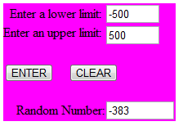
24
What is the absolute value of the number shown in the generator?
(Click for web site and set limits to -500 and 500)
Notes:
Answer: Answers will vary.

Slide 48
25
Which numbers have 12 as their absolute value?
A
-24
B
-12
C
0
D
12
E
24
Notes:
Answer: B, D

Slide 49
26
Which numbers have 50 as their absolute value?
A
-50
B
-25
C
0
D
25
E
50
Notes:
Answer: A, E

Slide 50
Comparing Integers
Return to
Table of
Contents

Slide 51
Comparing Positive Integers
An integer can be equal to; less than ; or greater than another integer.
The symbols that we use are:
Equals "=" Less than "<" Greater than ">"
For example:
4 = 4 4 < 6 4 > 2
When using < or >, remember that the smaller side points at the smaller number.

Slide 52
27
The integer 8 is ______ 9.
A
=
B
<
C
>
Notes:
Answer: B

Slide 53
28
The integer 7 is ______ 7.
A
=
B
<
C
>
Notes:
Answer: A

Slide 54
29
The integer 3 is ______ 5.
A
=
B
<
C
>
Notes:
Answer: B

Slide 55
Use the Number Line
To compare integers, plot points on
the number line.
The numbers farther to the right are greater.
The numbers farther to the left are smaller.
-10
-9
-8
-7
-6
-5
-4
-3
-2
-1
0
1
2
3
4
5
6
7
8
9
10

Slide 56
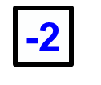
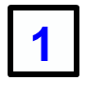
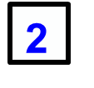
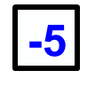
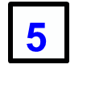
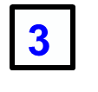
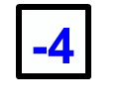
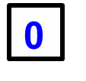
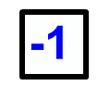
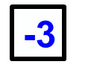
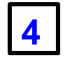
Place the number tiles in the correct places on the number line.

Slide 57
Comparing Negative Integers
The greater the absolute value of a negative integer, the smaller the integer. That's because it is farther from zero, but in the negative direction.
For example:
-4 = -4 -4 > -6 -4 < -2
-10
-9
-8
-7
-6
-5
-4
-3
-2
-1
0
1
2
3
4
5
6
7
8
9
10

Slide 58
Comparing Negative Integers
One way to think of this is in terms of money. You'd rather have $20 than $10.
But you'd rather owe someone $10 than $20.
Owing money can be thought of as having a negative amount of money, since you need to get that much money back just to get to zero.

Slide 59
Drag the appropriate inequality symbol between the following pairs of integers:
<
<
<
<
<
<
<
<
<
<
<
<
<
<
<
<
<
<
<
<
<
>
>
>
>
>
>
>
>
>
>
>
>
>
>
>
>
>
>
>
>
>
1) -3 5
3) 63 36
5) -6 -3
7) -24 -17
9) 8 -8
2) -237 -259
4) -10 -15
6) 127 172
8) -2 -8
10) -10 -7

Slide 60
30
The integer -4 is ______ -3.
A
=
B
<
C
>
-10
-9
-8
-7
-6
-5
-4
-3
-2
-1
0
1
2
3
4
5
6
7
8
9
10
Notes:
Answer: B

Slide 61
31
The integer -4 is ______ -5.
A
=
B
<
C
>
-10
-9
-8
-7
-6
-5
-4
-3
-2
-1
0
1
2
3
4
5
6
7
8
9
10
Notes:
Answer: C

Slide 62
32
The integer -20 is ______ -14.
A
=
B
<
C
>
Notes:
Answer: B

Slide 63
33
The integer -14 is ______ -6 .
A
=
B
<
C
>
Notes:
Answer: B

Slide 64
Comparing All Integers
Any positive number is greater than zero and any negative number.
Any negative number is less than zero and any positive number.

Slide 65
34
The integer -4 is ______ 6.
A
=
B
<
C
>
Notes:
Answer: B

Slide 66
35
The integer -3 is ______ 0.
A
=
B
<
C
>
Notes:
Answer: B

Slide 67
36
The integer 5 is ______ 0.
A
=
B
<
C
>
Notes:
Answer: C

Slide 68
37
The integer -4 is ______ -9.
A
=
B
<
C
>
Notes:
Answer: C

Slide 69
38
The integer 1 is ______ -54.
A
=
B
<
C
>
Notes:
Answer: C

Slide 70
39
The integer -480 is ______ 0.
A
=
B
<
C
>
Notes:
Answer: B

Slide 71
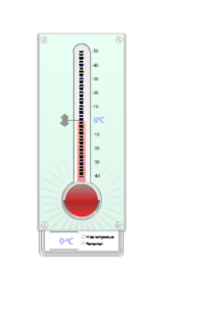
A thermometer can be thought of as a vertical number line. Positive numbers are above zero and negative numbers are below zero.

Slide 72
40
If the temperature reading on a thermometer is 10℃, what will the new reading be if the temperature:
falls 3 degrees?
Notes:
Answer: 7°C

Slide 73
41
If the temperature reading on a thermometer is 10℃, what will the new reading be if the temperature:
rises 5 degrees?
Notes:
Answer: 15°C

Slide 74
42
If the temperature reading on a thermometer is 10℃, what will the new reading be if the temperature:
falls 12 degrees?
Notes:
Answer: -2°C

Slide 75
43
If the temperature reading on a thermometer is
-3℃, what will the new reading be if the temperature:
falls 3 degrees?
Notes:
Answer: -6°C

Slide 76
44
If the temperature reading on a thermometer is -3℃, what will the new reading be if the temperature:
rises 5 degrees?
Notes:
Answer: 2°C

Slide 77
45
If the temperature reading on a thermometer is
-3℃, what will the new reading be if the temperature:
falls 12 degrees?
Notes:
Answer: -15°C

Slide 78
Comparing and Ordering Rational Numbers
Return to
Table of
Contents

Slide 79
Use the Number Line
To compare rational numbers, plot points on
the number line.
The numbers farther to the right are larger.
The numbers farther to the left are smaller.
-10
-9
-8
-7
-6
-5
-4
-3
-2
-1
0
1
2
3
4
5
6
7
8
9
10

Slide 80
46
What is the position of the dot on the number line below?
A
B
C
-10
-9
-8
-7
-6
-5
-4
-3
-2
-1
0
1
2
3
4
5
6
7
8
9
10
Notes:
Answer: B

Slide 81
47
What is the position of the dot on the number line below?
A
-5.5
B
-6.5
C
-5.2
-10
-9
-8
-7
-6
-5
-4
-3
-2
-1
0
1
2
3
4
5
6
7
8
9
10
Notes:
Answer: A

Slide 82
48
What is the position of the dot on the number line below?
A
B
C
-1
0
1
2
3
Notes:
Answer: B

Slide 83
49
What is the position of the dot on the number line below?
A
-0.8
B
-0.5
C
-0.6
-1
0
1
2
3
Notes:
Answer: A

Slide 84
Where do rational numbers go on the number line?
Go to the board and write in the following numbers:
-10
-9
-8
-7
-6
-5
-4
-3
-2
-1
0
1
2
3
4
5
6
7
8
9
10

Slide 85
Put these numbers on the number line.
-2
-10
-9
-8
-7
-6
-5
-4
-3
-2
-1
0
1
2
3
4
5
6
7
8
9
10
Which number is the largest? The smallest?

Slide 86
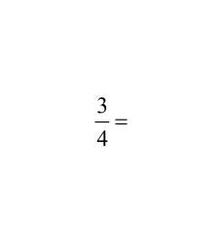
Comparing Rational Numbers
Sometimes you will be given fractions and decimals that you need to compare.
It is usually easier to convert all fractions to decimals in order to compare them on a number line.
To convert a fraction to a decimal, divide the numerator by the denominator.
0.75
4
3.00
-28
020
-20
0

Slide 87
Drag the appropriate inequality symbol between the following pairs of numbers:
<
<
<
<
<
<
<
<
<
<
<
<
<
<
<
<
<
<
<
<
<
>
>
>
>
>
>
>
>
>
>
>
>
>
>
>
>
>
>
>
>
>
1)
3)
5)
7)
9)
2)
4)
6)
8)
10)

Slide 88
50
A
=
B
<
C
>
-10
-9
-8
-7
-6
-5
-4
-3
-2
-1
0
1
2
3
4
5
6
7
8
9
10
Notes:
Answer: C

Slide 89
51
A
=
B
<
C
>
-10
-9
-8
-7
-6
-5
-4
-3
-2
-1
0
1
2
3
4
5
6
7
8
9
10
Notes:
Answer: B

Slide 90
52
A
=
B
<
C
>
-10
-9
-8
-7
-6
-5
-4
-3
-2
-1
0
1
2
3
4
5
6
7
8
9
10
Notes:
Answer: A

Slide 91
53
A
=
B
<
C
>
-10
-9
-8
-7
-6
-5
-4
-3
-2
-1
0
1
2
3
4
5
6
7
8
9
10
Notes:
Answer: B

Slide 92
54
A
=
B
<
C
>
-10
-9
-8
-7
-6
-5
-4
-3
-2
-1
0
1
2
3
4
5
6
7
8
9
10
Notes:
Answer: B

Slide 93
55
A
=
B
<
C
>
-10
-9
-8
-7
-6
-5
-4
-3
-2
-1
0
1
2
3
4
5
6
7
8
9
10
Notes:
Answer: B

Slide 94
Cartesian Plane
Return to
Table of
Contents

Slide 95
The development of the Coordinate or Cartesian plane is often credited to the French philosopher and mathematician, Rene Descartes. It is said that Descartes first came up with the idea for the plane as he lay in bed watching several flies crawl across his tiled ceiling; as he observed their movement he realized that he could use the intersecting lines formed by the tiles to describe a fly’s location. Although historical evidence suggests that a contemporary of Descartes, Pierre de Fermat, did more to develop the coordinate system, Rene Descartes’ work certainly revolutionized mathematics by describing the properties of the plane and using it as the first systematic link between Euclidean geometry and algebra.
"
"
Cogito,ergo sum
Pierre, bring me my fly swatter!
(1,1)
x
(-1,-1)
(2,-2)
Rene Descartes
1596 - 1650
y
The well known quote;
"Cogito,ergo sum"
(I think,therefore I am) is
attributed to Rene Descartes.
Fun Fact

Slide 96
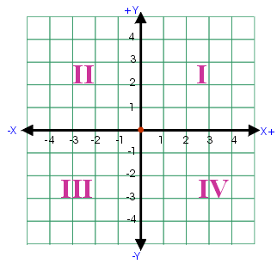
0
The coordinate plane is divided into four sections called quadrants.
Each quadrant is numbered using the Roman numerals I through IV, in a counter-clock wise direction.

Slide 97
C
Slide the "C"
onto the
coordinate plane
0
The Coordinate plane is also called the Cartesian plane.
One way to remember how the quadrants are numbered is to write a big "C" on top of the plane. The "C" will begin in quadrant I and end in quadrant IV.

Slide 98
y - axis
0
x - axis
The quadrants are formed by two intersecting number lines called axes.
The horizontal line is the x-axis.
The vertical line is the y-axis.

Slide 99
Origin
(0, 0)
0
The point at which the x and y axes intersect is called the origin. The coordinates of the origin are (0, 0).

Slide 100
0
Points can be plotted on the plane using one coordinate from each of the axes.
These sets are called ordered pairs. The x coordinate always appears first in these pairs. The y coordinate appears second.
(x, y)

Slide 101
Each of the quadrants can be identified by the properties of the numbers that fall within their plane. Remember the ordered pairs are always of the form (x, y)
(-,+)
( +,+)
0
(-,-)
(+,-)

Slide 102
56
What points are in quadrant II ?
A
B
C
D
E
F
Notes:
Answer: A, D

Slide 103
57
What points are in quadrant I ?
A
B
C
D
E
F
Notes:
Answer: E, F

Slide 104
58
What points are in quadrant IV ?
A
B
C
D
E
F
Notes:
Answer: C

Slide 105
59
What points are in quadrant III ?
A
B
C
D
E
F
Notes:
Answer: B

Slide 106
60
What point is closest to the origin?
A
B
C
D
E
F
Notes:
Answer: E

Slide 107
Graphing Ordered Pairs
Return to
Table of
Contents

Slide 108
To graph an ordered pair, such as (3,2):
start at the origin (0,0)
move left or right on the x-axis depending on the first number
then move up or down from there depending on the second number
plot the point

Slide 109
To graph (-3, 4):
Start at the origin and then move
3 left, up 4

Slide 110
To graph (-3, -2):
Start at the origin and then move
3 left, down 2

Slide 111
To graph (5, -3):
Start at the origin and then move
5 right, down 3

Slide 112
Place the star on (2,8) in quadrant I
Place the triangle on (-4, 4) in quadrant II
Place the square on (-7, -3) in quadrant III
Place the circle on (1, -4) in quadrant IV

Slide 113
Place the circle on (-7,-5)
Place the star on (4,9)
Place the triangle on (-6,2)
Place the square on (3,-9)
In which quadrant is the circle?

Slide 114
Place the circle on (-4, -3)
Place the star on (4,3)
Place the triangle on (-4, 3)
Place the square on (4, -3)
What do you notice about the location of the points in relation to each other? What do you notice about the coordinates of the points?

Slide 115
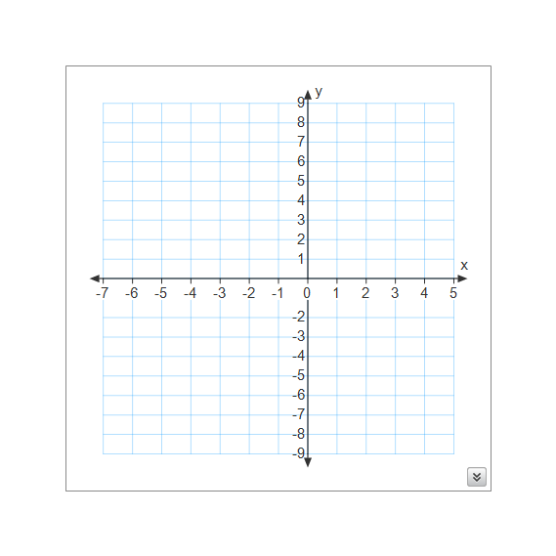
Click for answer
When two ordered pairs differ only by their signs, the locations of the points are reflections of each other across one or both axes.
(-4, 3)
(4,3)
(-4, -3)
(4, -3)

Slide 116
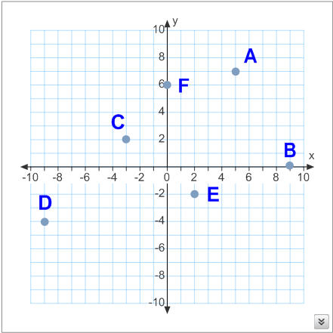
Move the letter to match it to the correct coordinate point. Then move the circle to check your answer.
A
(-9,-4)
D
A
F
E
(2,-2)
C
B
(9,0)
B
D
E
(0,6)
F
(5,7)
A
(-3,2)
C

Slide 117
61
The point (-5, 4) is located in quadrant_____.
A
I
B
II
C
III
D
IV
Notes:
Answer: B

Slide 118
62
The point (7, -2) is located in quadrant _____.
A
I
B
II
C
III
D
IV
Notes:
Answer: D

Slide 119
63
The point (4, 5) is located in quadrant ____.
A
I
B
II
C
III
D
IV
Notes:
Answer: A

Slide 120
64
The quadrant where the x & y coordinates are both negative is quadrant ___.
A
I
B
II
C
III
D
IV
Notes:
Answer: C

Slide 121
65
When plotting points in the Cartesian Plane, you always start at ____.
A
the x - axis
B
the origin
C
the y-axis
D
the Coordinate Plane
E
(0,0)
Notes:
Answer: B, E

Slide 122
List the coordinates of each point
A
B
C
D
E
F
A (-2,2)
B (-2,-4)
C (0,-3)
D (2,-1)
E (3,4)
F (5,0)
Click
here for answers
Notes:
Answers: A(-2,2), B(-2,4), C(0,-3), D(2,-1), E(3,4), F(5,0)

Slide 123
List the coordinates of each point
A
B
C
D
E
F
A (-4,3)
B (0,3)
C (-5,-3)
D (0,-1)
E (3,2)
F (4,-4)
Click
here for answers
Notes:
Answers: A(-4,3), B(0,3), C(-5,-3), D(0,-1), E(3,2), F(4,-4)

Slide 124
List the coordinates of each point
A
B
C
D
E
F
A (3,-2)
B (0,-4)
C (0,5)
D (-4,0)
E (4,-1)
F (1,3)
Click
here for answers
Notes:
Answers: A(3,-2), B(0,-4), C(0,5), D(-4,0), E(4,-1), F(1,3)

Slide 125
66
If the x-coordinate is positive, the point to be plotted will be in quadrant _____.
A
I
B
I & II
C
I & IV
D
II
Notes:
Answer: C

Slide 126
67
If the y-coordinate is positive, the point to be plotted will be in quadrant _____.
A
I
B
I & II
C
I & IV
D
II
Notes:
Answer: B

Slide 127
68
If the x - coordinate is negative and the y-coordinate is positive, the point to be plotted will be in quadrant _____.
A
I
B
I & II
C
I & IV
D
II
Notes:
Answer: D

Slide 128
69
If the x - coordinate is positive and the y-coordinate is negative, the point to be plotted will be in quadrant _____.
A
I
B
II
C
III
D
IV
Notes:
Answer: D

Slide 129
70
Point A is located at (-3, 2)
True
False
Notes:
Answer: False

Slide 130
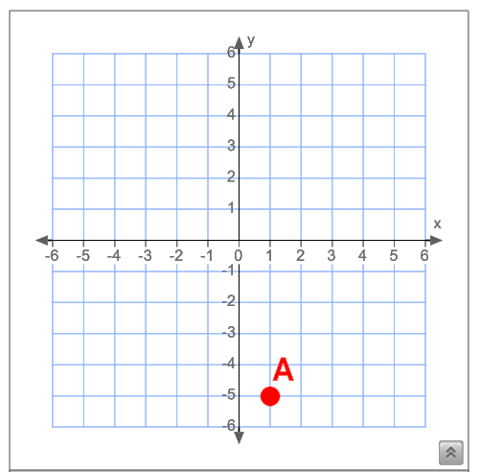
71
Point A is located at (-5, 1)
True
False
Notes:
Answer: False

Slide 131
72
Point A is located at (-2, 3)
True
False
Notes:
Answer: True

Slide 132
73
Point A is located at (-2, 0)
True
False
Notes:
Answer: False

Slide 133
Cartesian Plane Applications
Return to
Table of
Contents

Slide 134
Vocabulary Review
×
Coordinate Plane: the two dimensional plane or flat surface that is created when the x-axis intersects with the y-axis. Also known as a coordinate graph and the Cartesian plane.
II
I
Quadrant: any of the four regions created when the x-axis intersects the y-axis. They are usually numbered with Roman numerals.
III
IV

Slide 135
Vocabulary Review
×
x-axis: horizontal number line that extends indefinitely in both directions from zero. (Right- positive Left- negative)
II
I
y-axis: vertical number line that extends indefinitely in both directions from zero. (Up- positive Down- negative)
III
IV
Origin: the point where zero on the x-axis intersects zero on the y-axis. The coordinates of the origin are (0,0).

Slide 136
74
The points (-6, 2) and (3, 2) are plotted below. What is the distance between these two points?
Notes:
Teacher Instructions: At this point, students should just count to see the distance between the point. In a few pages, they will study a table to see how the distance can be found without the coordinate grid.
Answer: 9

Slide 137
75
The points (-5, 4) and (1, 4) are plotted below. What is the distance between these two points?
Notes:
Answer: 6

Slide 138
76
Plot and connect the following points: M(1,2), A(-1,2), T (1,4), H (-1,4). What is the distance of MA?
Notes:
Answer: 2

Slide 139
77
Plot and connect the following points: A(-2,2), B(6,2), C (0,4) What is the distance of AC?
Notes:
Answer: 8

Slide 140
Study the table below. What pattern do you see between the set of points and the distance between them?
Is there a way to find the distance between the two points without graphing them first on a coordinate plane?
Points | Distance
(-6, 2) (3, 2) | 9
(-5, 4) (1, 4) | 6
(-2, 6) (-2, -4) | 10
(-5, 7) (-5, 3) | 4
(3, -3) (8, -3) | 5

Slide 141
If two points have either the same x- or y-coordinate, the distance between them can be as follows:
If the different coordinates are either both positive or both negative, subtract their absolute values.
If the different coordinates are opposite signs, add their absolute values.
Let's look at the table again to see how this works:
Points | Distance
(-6, 2) (3, 2) | |-6| + |3| = 6 + 3 = 9
(-5, 4) (1, 4) | |-5| + |1| = 5 + 1 = 6
(-2, 6) (-2, -4) | |6| + |-4| = 6 + 4 = 10
(-5, 7) (-5, 3) | |7 - 3| = |4| = 4
(3, -3) (8, -3) | |3 - 8| = |-5| = 5

Slide 142
78
Find the distance between (-8, 4) and (-8, 9).
Notes:
Answer: 5

Slide 143
79
Find the distance between (6, 9) and (-2, 9).
Notes:
Answer: 8

Slide 144
80
Find the distance between (5, -7) and (5, -2).
Notes:
Answer: 5

Slide 145
81
Given the points A(-3,-3), B(2,-3), C (-3,0), D (2,0), what is the distance of CD?
Notes:
Answer: 5

Slide 146
82
Given the points X (-3, -2), Y (0,2), Z (3, -2), what is the distance of XZ?
Notes:
Answer: 6

