Slide 1
New Jersey Center for Teaching and Learning
Progressive Mathematics Initiative
This material is made freely available at www.njctl.org and is intended for the non-commercial use of students and teachers. These materials may not be used for any commercial purpose without the written permission of the owners. NJCTL maintains its website for the convenience of teachers who wish to make their work available to other teachers, participate in a virtual professional learning community, and/or provide access to course materials to parents, students and others.
Click to go to website:
www.njctl.org

Slide 2
6th Grade Math
Statistics
2012-11-16
www.njctl.org

Slide 3
Setting the PowerPoint View
Use Normal View for the Interactive Elements
To use the interactive elements in this presentation, do not select the Slide Show view. Instead, select Normal view and follow these steps to set the view as large as possible:
On the View menu, select Normal.
Close the Slides tab on the left.
In the upper right corner next to the Help button, click the ^ to minimize the ribbon at the top of the screen.
On the View menu, confirm that Ruler is deselected.
On the View tab, click Fit to Window.
Use Slide Show View to Administer Assessment Items
To administer the numbered assessment items in this presentation, use the Slide Show view. (See Slide 11 for an example.)

Slide 4
Table of Contents
Measures of Center
Click on a topic to go to that section.
Mean
Median
Mode
Central Tendency Application Problems
Measures of Variation
Minimum/Maximum
Range
Quartiles
Outliers
Mean Absolute Deviation
Data Displays
Frequency Tables and Histograms
Box-and-Whisker Plots
Dot Plots
Analyzing Data Displays
Common Core: 6.SP.1-5

Slide 5
Measures of Center
Return to
Table of
Contents

Slide 6
Activity
Each of your group members will draw a color card.
Each person will take all the tiles of their color from the bag.
Discussion Questions
·How many tiles does your group have in total?
·How can you equally share all the tiles? How many would
each member receive? (Ignore the color)
·Each member has a different number of tiles according to
color. Write out a list of how many tiles each person has from
least to greatest. Look at the two middle numbers. What
number is in between these two numbers?
Notes:
Teacher’s instructions: Separate students into groups of 4.
Prepare bags with 4 different colored tiles or cubes. (Use the numbers 2, 3, 7, and 12.)
Prepare index cards written with the colors of the tiles or cubes.

Slide 7
Follow-Up Discussion
What is the significance of the number you found when you shared the tiles equally?
This number is called the mean (or average). It tells us that if you evenly distributed the tiles, each person would receive that number.
What is the significance of the number you found that shows two members with more tiles and two with less?
This number is called the median. It is in the middle of the all the numbers. This number shows that no matter what each person received, half the group had more than that number and the other half had less.

Slide 8
Measures of Center Vocabulary:
·Mean - The sum of the data values divided by the number
of items; average
·Median - The middle data value when the values are
written in numerical order
·Mode - The data value that occurs the most often

Slide 9
Finding the Mean
To find the mean of the ages for the Apollo pilots given below, add their ages. Then divide by 7, the number of pilots.
Apollo Mission | 11 | 12 | 13 | 14 | 15 | 16 | 17
Pilot's age | 39 | 37 | 36 | 40 | 41 | 36 | 37
Mean = 39 + 37 + 36 + 40 + 41 + 36 +37 = 266 = 38
7 7
Click to reveal answer
The mean of the Apollo pilots' ages is 38 years.

Slide 10
Find the mean
10, 8, 9, 8, 5
8

Slide 11
1
Find the mean
20, 25, 25, 20, 25
Notes:
Answer: 23

Slide 12
2
Find the mean
14, 17, 9, 2, 4,10, 5, 3
Notes:
Answer: 8

Slide 13
Given the following set of data, what is the median?
10, 8, 9, 8, 5
8
What do we do when finding the median of an even set of numbers?

Slide 14
When finding the median of an even set of numbers, you must take the mean of the two middle numbers.
Find the median
12, 14, 8, 4, 9, 3
8.5

Slide 15
3
Find the median: 5, 9, 2, 6, 10, 4
A
5
B
5.5
C
6
D
7.5
Notes:
Answer: B

Slide 16
4
Find the median: 15, 19, 12, 6, 100, 40, 50
A
15
B
12
C
19
D
6
Notes:
Answer: C

Slide 17
5
Find the median: 1, 2, 3, 4, 5, 6
A
3 & 4
B
3
C
4
D
3.5
Notes:
Answer: D

Slide 18
6
What number can be added to the data set below so that the median is 134?
54, 156, 134, 79, 139, 163
Notes:
Answer: Any number less than 133.

Slide 19
7
What number can be added to the data set below so that the median is 16.5?
17, 9, 4, 16, 29,
Notes:
Answer: Any number greater than 17 or less than 16.

Slide 20
What do the mean and median tell us about the data?
Mr. Smith organized a scavenger hunt for his students. They had to find all the buried "treasure". The following data shows how many coins each student found.
10, 7, 3, 8, 2
Find the mean and median of the data.
What does the mean and median tell us about the data?
Notes:
Teacher’s instructions: The mean is 6 and the median is 7.
The mean tells us that if the data were evenly distributed, each student would have 6 coins.
The median tells us that half the class has more than 7 coins and the other half has less than 7.

Slide 21
Find the mode
10, 8, 9, 8, 5
8
Find the mode
1, 2, 3, 4, 5
No mode
What can be added to the set of data above, so that there are two modes? Three modes?

Slide 22
8
What number(s) can be added to the data set so that there are 2 modes: 3, 5, 7, 9, 11, 13, 15 ?
A
3
B
6
C
8
D
9
E
10
Notes:
Answer: A & D

Slide 23
9
What value(s) must be eliminated so that data set has 1 mode: 2, 2, 3, 3, 5, 6 ?
Notes:
Answer: 2 or 3

Slide 24
10
Find the mode(s): 3, 4, 4, 5, 5, 6, 7, 8, 9
A
4
B
5
C
9
D
No mode
Notes:
Answer: A & C

Slide 25
11
What number can be added to the data set below so that the mode is 7?
5, 3, 4, 4, 6, 9, 7, 7
Notes:
Answer: 7

Slide 26
Central Tendency
Application Problems
Return to
Table of
Contents

Slide 27
Jae bought gifts that cost $24, $26, $20 and $18. She has one more gift to buy and wants her mean cost to be $24. What should she spend for the last gift?
3 Methods:
Method 1: Guess & Check
Try $30
24 + 26 + 20 + 18 + 30 = 23.6
5
Try a greater price, such as $32
24 + 26 + 20 + 18 + 32 = 24
5
The answer is $32.

Slide 28
Jae bought gifts that cost $24, $26, $20 and $18. She has one more gift to buy and wants her mean cost to be $24. What should she spend for the last gift?
Method 2: Work Backward
In order to have a mean of $24 on 5 gifts, the sum of all 5 gifts must be
$24 ⋅ 5 = $120.
The sum of the first four gifts is $88. So the last gift should cost
$120 - $88 = $32.
24 ⋅ 5 = 120
120 - 24 - 26 - 20 - 18 = 32

Slide 29
Jae bought gifts that cost $24, $26, $20 and $18. She has one more gift to buy and wants her mean cost to be $24. What should she spend for the last gift?
3 Methods:
Method 3: Write an Equation
Let x = Jae's cost for the last gift.
24 + 26 + 20 + 18 + x = 24
5
88 + x = 24
5
88 + x = 120 (multiplied both sides by 5)
x = 32 (subtracted 88 from both sides)

Slide 30
Your test scores are 87, 86, 89, and 88. You have one more test in the marking period.
You want your average to be a 90. What score must you get on your last test?
Pull
Pull
Notes:
Teacher’s instructions:
87 + 86 + 89 + 88 + x = 90
5
350 + x = 90
5
350 + x = 450
x = 100
You need a 100 on your test

Slide 31
12
Your test grades are 72, 83, 78, 85, and 90. You have one more test and want an average of an 82. What must you earn on your next test?
Notes:
Answer:
72 + 83 + 78 + 85 + 90 + x = 82
6
408 + x = 82
6
408 + x = 492
x = 84

Slide 32
13
Your test grades are 72, 83, 78, 85, and 90. You have one more test and want an average of an 85. Your friend figures out what you need on your next test and tells you that there is "NO way for you to wind up with an 85 average. Is your friend correct? Why or why not?
Yes
No
Notes:
Answer: Yes my friend is correct because I would need a 102 on the next test.
72 + 83 + 78 + 85 + 90 + x = 85
6
408 + x = 85
6
408 + x = 510
x = 102

Slide 33
Consider the data set: 50, 60, 65, 70, 80, 80, 85
The mean is:
The median is:
The mode is:
What happens to the mean, median and mode if 60 is added to the set of data?
Mean:
Median:
Mode:
Note: Adding 60 to the data set lowers the mean and the median
Notes:
Mean: 70, Median: 70, Mode: 80
After adding 60: Mean 68.75, Median: 67.5, Mode: 60 & 80

Slide 34
Consider the data set: 55, 55, 57, 58, 60, 63
·The mean is 58
·the median is 57.5
·and the mode is 55
What would happen if a value x was added to the set?
How would the mean change:
if x was less than the mean?
if x equals the mean?
if x was greater than the mean?
Notes:
If x was less than the mean, the mean would decrease
If x equaled the mean, the mean would not change.
If x was greater than the mean, the mean would increase.

Slide 35
Let's further consider the data set: 55, 55, 57, 58, 60, 63
·The mean is 58
·the median is 57.5
·and the mode is 55
What would happen if a value, "x", was added to the set?
How would the median change:
if x was less than 57?
if x was between 57 and 58?
if x was greater than 58?
Notes:
If x was less than 57, the median would decrease to 57.
If x was between 57 & 58, the median increase or decrease to that number added between 57 & 58.
If x was greater than 58, the median would increase to 58.

Slide 36
Consider the data set: 10, 15, 17, 18, 18, 20, 23
·The mean is 17.3
·the median is 18
·and the mode is 18
What would happen if the value of 20 was added to the data set?
How would the mean change?
How would the median change?
How would the mode change?
Notes:
Mean: 17.625
Median: 18
Mode: 18 & 20

Slide 37
Consider the data set: 55, 55, 57, 58, 60, 63
·The mean is 58
·the median is 57.5
·and the mode is 55
What would happen if a value, "x", was added to the set?
How would the mode change:
if x was 55?
if x was another number in the list other than 55? if x was a number not in the list?
Notes:
If x was 55, the mode would stay the same at 55.
If x was another number on the list other than 55, there would be another mode.
If x was a number not on the list, the mode would stay the same at 55.

Slide 38
14
Consider the data set: 78, 82, 85, 88, 90. Identify the data values that remain the same if "79" is added to the set.
A
mean
B
median
C
mode
D
range
E
minimum
Notes:
Answer: C, D, E

Slide 39
Measures of Variation
Return to
Table of
Contents

Slide 40
Measures of Variation Vocabulary:
Minimum - The smallest value in a set of data
Maximum - The largest value in a set of data
Range - The difference between the greatest data value and the least data value
Quartiles - are the values that divide the data in four equal parts.
Lower (1st) Quartile (Q1) - The median of the lower half of the data
Upper (3rd) Quartile (Q3) - The median of the upper half of the data.
Interquartile Range - The difference of the upper quartile and the lower quartile. (Q3 - Q1)
Outliers - Numbers that are significantly larger or much smaller than the rest of the data

Slide 41
Minimum and Maximum
14, 17, 9, 2, 4, 10, 5
What is the minimum in this set of data?
2
What is the maximum in this set of data?
17

Slide 42
Given a maximum of 17 and a minimum of 2, what is the range?
15

Slide 43
15
Find the range: 4, 2, 6, 5, 10, 9
A
5
B
8
C
9
D
10
Notes:
Answer: B

Slide 44
16
Find the range, given a data set with a maximum value of 100 and a minimum value of 1
Notes:
Answer: 99

Slide 45
17
Find the range for the given set of data:
13, 17, 12, 28, 35
Notes:
Answer: 23

Slide 46
18
Find the range: 32, 21, 25, 67, 82
Notes:
Answer: 61

Slide 47
Quartiles
There are three quartiles for every set of data.
Lower
Half
Upper
Half
10, 14, 17, 18, 21, 25, 27, 28
Q1
Q2
Q3
The lower quartile (Q1) is the median of the lower half of the data which is 15.5.
The upper quartile (Q3) is the median of the upper half of the data which is 26.
The second quartile (Q2) is the median of the entire data set which is 19.5.
The interquartile range is Q3 - Q1 which is equal to 10.5.

Slide 48
To find the first and third quartile of an odd set of data, ignore the median (Q2) when analyzing the lower and upper half of the data.
2, 5, 8, 7, 2, 1, 3
First order the numbers and find the median (Q2).
1, 2, 2, 3, 5, 7, 8
What is the lower quartile, upper quartile, and interquartile range?
First Quartile: 2
Median: 3
Third Quartile: 7
Interquartile Range: 7 - 2 = 5
Click to Reveal

Slide 49
19
The median (Q2) of the following data set is 5.
3, 4, 4, 5, 6, 8, 8
True
False
Notes:
Answer: True

Slide 50
20
What are the lower and upper quartiles of the data set
3, 4, 4, 5, 6, 8, 8?
A
Q1: 3 and Q3: 8
B
Q1: 3.5 and Q3: 7
C
Q1: 4 and Q3: 7
D
Q1: 4 and Q3: 8
Notes:
Answer: D

Slide 51
What is the interquartile range of the data set
3, 4, 4, 5, 6, 8, 8?
Notes:
Answer: 4

Slide 52
22
What is the median of the data set
1, 3, 3, 4, 5, 6, 6, 7, 8, 8?
A
5
B
5.5
C
6
D
No median
Notes:
Answer: 5.5

Slide 53
23
What are the lower and upper quartiles of the data set
1, 3, 3, 4, 5, 6, 6, 7, 8, 8?
(Pick two answers)
D
A
Q3: 6
Q1: 1
E
B
Q3: 7
Q1: 3
F
C
Q3: 8
Q1: 4
Notes:
Answer: B & E

Slide 54
24
What is the interquartile range of the data set
1, 3, 3, 4, 5, 6, 6, 7, 8, 8?
Notes:
Answer: 4

Slide 55
Outliers - Numbers that are relatively much larger or much smaller than the data
Which of the following data sets have outlier(s)?
A. 1, 13, 18, 22, 25
B. 17, 52, 63, 74, 79, 83, 120
C. 13, 15, 17, 21, 26, 29, 31
D. 25, 32, 35, 39, 40, 41
Notes:
Answer: A, B

Slide 56
When the outlier is not obvious, a general rule of thumb is that the outlier falls more than 1.5 times the interquartile range below Q1 or above Q3.
Consider the set 1, 5, 6, 9, 17.
Q1: 3
Q2: 6
Q3: 13
IQR: 10
1.5 x IQR = 1.5 x 10 = 15
Q1 - 15 = 3 - 15 = -12
Q3 + 15 = 13 + 15 = 28
In order to be an outlier, a number should be smaller than -12 or larger than 28.

Slide 57
25
Which of the following data sets have outlier(s)?
A 13, 18, 22, 25, 100
B 17, 52, 63, 74, 79, 83
C 13, 15, 17, 21, 26, 29, 31, 75
D 1, 25, 32, 35, 39, 40, 41
Notes:
Answer: A, C, D

Slide 58
26
The data set: 1, 20, 30, 40, 50, 60, 70 has an outlier which is ________ than the rest of the data.
A
higher
B
lower
C
neither
Notes:
Answer: B
Even though 1 does not follow the general rule, it is obvious that it does not belong.

Slide 59
In the following data what number is the outlier? { 1, 2, 2, 4, 5, 5, 5, 13}
27
Notes:
Answer: 13

Slide 60
28
In the following data what number is the outlier? { 27, 27.6, 27.8 , 27.8, 27.9, 32}
Notes:
Answer: 32

Slide 61
29
In the following data what number is the outlier? { 47, 48, 51, 52, 52, 56, 79}
Notes:
Answer: 79

Slide 62
The data value that occurs most often is called the
30
A
mode
B
range
C
median
D
mean
Notes:
Answer: A

Slide 63
31
The middle value of a set of data, when ordered from lowest to highest is the _________
A
mode
B
range
C
median
D
mean
Notes:
Answer: C

Slide 64
32
Find the maximum value: 15, 10, 32, 13, 2
A
2
B
15
C
13
D
32
Notes:
Answer: D

Slide 65
33
Identify the outlier(s): 78, 81, 85, 92, 96, 145
Notes:
Answer: 145

Slide 66
34
If you take a set of data and subtract the minimum value from the maximum value, you will have found the ______
A
outlier
B
median
C
mean
D
range
Notes:
Answer: D

Slide 67
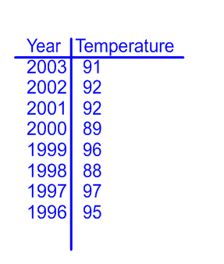
Find the mean, median, range, quartiles, interquartile range and outliers for the data below.
High Temperatures for Halloween

Slide 68
High Temperatures for Halloween
88 89 90 91 92 93 94 95 96 97
High Temperatures for Halloween
Mean
Median
Range
Lower Quartile
Upper Quartile
Interquartile Range
Outliers
740 = 92.5
92
97− 88 = 9
90
95.5
5.5
None
Year Temperature
2003 91
2002 92
2001 92
2000 89
1999 96
1998 88
1997 97
1996 95
8
Notes:
Teacher’s instructions: One way to organize your data is to create a line plot. Write the numbers below the line and place an "x" above the number each time it appears in the data set.

Slide 69
Find the mean, median, range, quartiles, interquartile range and outliers for the data.
Candy Calories
Butterscotch Discs 60
Candy Corn 160
Caramels 160
Gum 10
Dark Chocolate Bar 200
Gummy Bears 130
Jelly Beans 160
Licorice Twists 140
Lollipop 60
Milk Chocolate Almond 210
Milk Chocolate 210

Slide 70
Calories from Candy
0 10 20 30 40 50 60 70 80 90 100 110 120 130 140 150 160 170 180 190 200 210
Candy Calories
Butterscotch Discs 60
Candy Corn 160
Caramels 160
Gum 10
Dark Chocolate Bar 200
Gummy Bears 130
Jelly Beans 160
Licorice Twists 140
Lollipop 60
Milk Chocolate Almond 210
Milk Chocolate 210
1500 ≈136.26
160
210 −10 = 200
60
200
140
10
Mean
Median
Range
Lower Quartile
Upper Quartile
Interquartile Range
Outliers
11

Slide 71
Mean Absolute Deviation
Return to
Table of
Contents

Slide 72
Activity
The table below shows the number of minutes eight friends have talked on their cell phones in one day. In your groups, answer the following questions.
1. Find the mean of the data.
What is the difference between the data value 52 and the
mean?
3. Which value is farthest from the mean?
Overall, are the data values close to the mean or far away
from the mean? Explain.
Phone Usage (Minutes)
52 | 48 | 60 | 55
59 | 54 | 58 | 62
Notes:
Teacher’s instructions:
1) 56 minutes
2) 4 minutes
3) 48 minutes
4) Overall they are close to the mean with the exception of 48

Slide 73
The mean absolute deviation of a set of data is the average distance between each data value and the mean.
Steps
1. Find the mean.
2. Find the distance between each data value and the mean.
That is, find the absolute value of the difference between
each data value and the mean.
3. Find the average of those differences.
*HINT: Use a table to help you organize your data.

Slide 74
Let's continue with the "Phone Usage" example.
Step 1 - We already found the mean of the data is 56.
Step 2 - Now create a table to find the differences.
Absolute Value of the Difference
|Data Value - Mean|
Data Value
48 | 8
52 | 4
54 | 2
55 | 1
58 | 2
59 | 3
60 | 4
62 | 6

Slide 75
Step 3 - Find the average of those differences.
8 + 4 + 2 + 1 + 2 + 3 + 4 + 6 = 3.75
8
The mean absolute deviation is 3.75.
The average distance between each data value and the mean is 3.75 minutes.
This means that the number of minutes each friend talks on the phone varies 3.75 minutes from the mean of 56 minutes.

Slide 76
Try This!
The table shows the maximum speeds of eight roller coasters at Eight Flags Super Adventure. Find the mean absolute deviation of the set of data. Describe what the mean absolute deviation represents.
Maximum Speeds of Roller Coasters (mph)
58 | 88 | 40 | 60
72 | 66 | 80
48
Notes:
Teacher’s instructions: Mean is 64 mph.
The mean absolute deviation is 12.5.
This means that the average distance each data value is from the mean is 12.5 miles per hour.

Slide 77
35
Find the mean absolute deviation of the given set of data.
Zoo Admission Prices
$9.50 $9.00 $8.25
$9.25 $8.00 $8.50
A
$0.50
B
$8.75
C
$3.00
D
$9.00
Notes:
Answer: A

Slide 78
36
Find the mean absolute deviation for the given set of data.
Number of Daily Visitors to a Web Site
112 145 108 160 122
Notes:
Answer: 18.48

Slide 79
37
Find the mean absolute deviation for the given set of data. Round to the nearest hundredth.
65 63 33 45 72 88
Notes:
Answer: 14.67

Slide 80
38
Find the mean absolute deviation for the given set of data. Round to the nearest hundredth.
Prices of Tablet Computers
$145 $232 $335 $153 $212 $89
Notes:
Answer: 65.33

Slide 81
DATA DISPLAYS
Return to
Table of
Contents

Slide 82
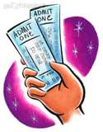
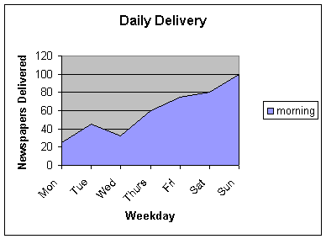
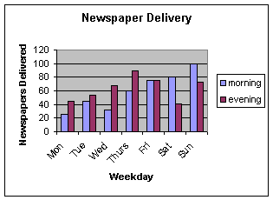
Tables
Ticket Sales for School Play
 | Friday | Saturday | Sunday
7 PM | 78 | 67 | 65
9 PM | 82 | 70 | 30
Matinee | NA | 35 | 82
Charts
Graphs

Slide 83
Frequency Tables & Histograms
Return to
Table of
Contents

Slide 84
A frequency table shows the number of times each data item appears in an interval.
To create a frequency table, choose a scale that includes all of the numbers in the data set.
Next, determine an interval to separate the scale into equal parts.
The table should have the intervals in the first column, tally in the second and frequency in the third.
Time Tally Frequency
10-19 IIII 4
20-29 0
30-39 IIII 5
40-49 IIII 4
50-59 0
60-69 III 3

Slide 85
The following are the test grades from a previous year.
Organize the data into a frequency table.
95 85 93
77 97 71
84 63 87
39 88 89
71 79 83
82 85

Slide 86
95 85 93
77 97 71
84 63 87
39 88 89
71 79 83
82 85
Determine Range,
Scale & Interval
Step 1: Find the range of the data then determine a scale and interval.
Hint: Divide the range of data by the number of intervals you would like to have and then use the quotient as an approximate interval size.
RANGE: 97 - 39 = 59
SCALE: 59/6 = 9.5555 so 10 would be the size of the intervals
INTERVALS: 30-39, 40-49, 50-59, 60-69, 70-79, 80-89, 90-99

Slide 87
95 85 93
77 97 71
84 63 87
39 88 89
71 79 83
82 85
Create a Frequency Table
Test Grades
Grade Tally Frequency
Grade Tally Frequency
30-39 I 1
40-49 0
50-59 0
60-69 I 1
70-79 IIII 4
80-89 IIII III 8
90-99 III 3
Move to see answer

Slide 88
Create a Frequency Table for the data.
Length of Time Walking
15 30 15 45
45 30 30 60
30 60 15 30
45 45 60 15
Walking Time
Time Tally Frequency
10-19 IIII 4
20-29 0
30-39 IIII 5
40-49 IIII 4
50-59 0
60-69 III 3
Move to see answer
Notes:
Teacher’s instructions:
Range: 60 - 15 = 45
Interval: 45/5 = 9 so 10

Slide 89
A histogram is a bar graph that shows data in intervals. It is used to show continuous data.
Since the data is shown in intervals, there is no space between the bars.
Test Grades
F
R
E
Q
U
E
N
C
Y
8
6
4
2
0
30- 40- 50- 60- 70- 80- 90-
39 49 59 69 79 89 99
GRADE

Slide 90
95 85 93
77 97 71
84 63 87
39 88 89
71 79 83
82 85
Create a
Histogram
Test Grades
Test Grades
Grade Tally Frequency
30-39 I 1
40-49 0
50-59 0
60-69 I 1
70-79 IIII 4
80-89 IIII III 8
90-99 III 3
F
R
E
Q
U
E
N
C
Y
8
6
4
2
0
30- 40- 50- 60- 70- 80- 90-
39 49 59 69 79 89 99
GRADE
Note: Frequency tables and histograms show data in intervals

Slide 91
Test Grades
F
R
E
Q
U
E
N
C
Y
8
6
4
2
0
Questions
30- 40- 50- 60- 70- 80- 90-
39 49 59 69 79 89 99
GRADE
1. How many students scored an A?
2. How many students scored an 87?
3. How are histograms and bar graphs alike?
4. How are histograms and bar graphs different?
5. Why are there no spaces between the bars of a histogram?

Slide 92
Test Grades
F
R
E
Q
U
E
N
C
Y
8
6
4
2
0
30- 40- 50- 60- 70- 80- 90-
39 49 59 69 79 89 99
GRADE
Notice that the test scores are closely grouped except one.
In statistics when a value is much different than the rest of the data set it is called an outlier.

Slide 93
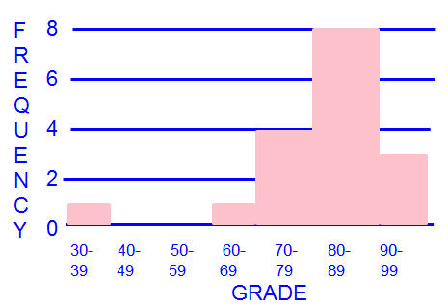
EXAMPLE:
TEST SCORES
95 85 93
77 97 71
84 63 87
39 88 89
71 79 83
82 85
Grade Tally Frequency
30-39 I 1
40-49 0
50-59 0
60-69 I 1
70-79 IIII 4
80-89 IIII III 8
90-99 III 3

Slide 94
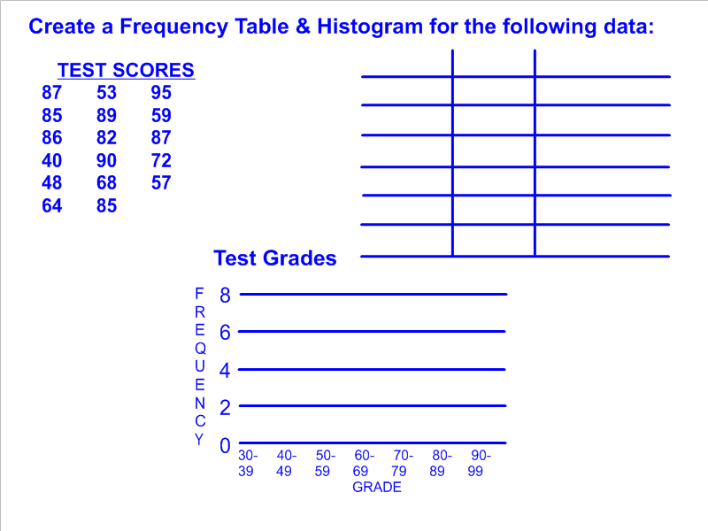

Slide 95
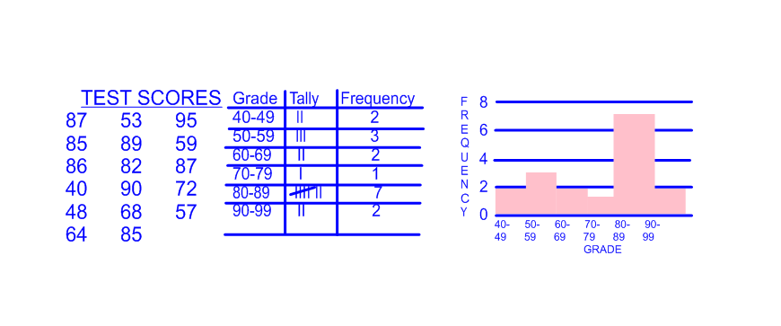
Move box for answer.

Slide 96
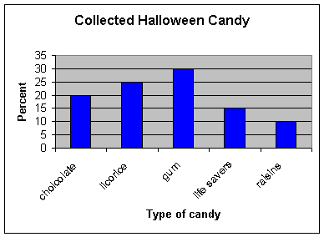
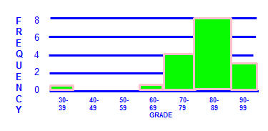
Compare & Contrast Bar Graphs and Histograms.
Both compare data in different categories and use bars to show amounts.
Histograms show data in intervals, the height of the bar shows the frequency in the interval and there are no spaces between the bars.
Bar Graphs show a specific value for a specific category, and have a space between bars to separate the categories.

Slide 97
Box and Whisker Plots
Return to
Table of
Contents

Slide 98
A box and whisker plot is a data display that organizes data into four groups
-10
-9
-8
-7
-6
-5
-4
-3
-2
-1
0
1
2
3
4
5
6
7
8
9
10
80 90 100 110 120 130 140 150
The median divides the data into an upper and lower half
The median of the lower half is the lower quartile.
The median of the upper half is the upper quartile.
The least data value is the minimum.
The greatest data value is the maximum.

Slide 99
-10
-9
-8
-7
-6
-5
-4
-3
-2
-1
0
1
2
3
4
5
6
7
8
9
10
80 90 100 110 120 130 140 150
Drag the terms below to the correct position on the box and whisker graph.
median
lower quartile
upper quartile
maximum
minimum

Slide 100
25%
25%
25%
25%
80 90 100 110 120 130 140 150
median
The entire box represents 50% of the data. 25% of the data lie in the box on each side of the median
Each whisker represents
25% of the data

Slide 101
39
The minimum is
A
87
B
104
C
122
D
134
Notes:
Answer: A

Slide 102
40
The median is
A
87
B
104
C
122
D
134
Notes:
Answer: C

Slide 103
41
The lower quartile is
A
87
B
104
C
122
D
134
Notes:
Answer: B

Slide 104
42
The upper quartile is
A
87
B
104
C
122
D
134
Notes:
Answer: D

Slide 105
43
In a box and whisker plot, 75% of the data is between
A
the minimum and median
B
the minimum and maximum
C
the lower quartile and maximum
D
the minimum and the upper quartile
Notes:
Answer: C & D are both correct

Slide 106
In a box and whisker plot, 50% of the data is between
44
A
the minimum and median
B
the minimum and maximum
C
the lower quartile and upper quartile
D
the median and maximum
Notes:
Answer: A, C, and D are all correct

Slide 107
45
In a box and whisker plot, 100% of the data is between
A
the minimum and median
B
the minimum and maximum
C
the lower quartile and upper quartile
D
the median and maximum
Notes:
Answer: B

Slide 108
Steps for creating a box and whisker plot:
88 96 96 97 101 105 105 107 111 112
115 119 122 122 122 124 125 128 129 132
133 136 138 139 139 147 148
Find the following:
·Minimum
·Lower Quartile
·Median
·Upper Quartile
·Maximum
Notes:
Answer:
Minimum 88
Lower Quartile 105
Median 22
Upper Quartile 133
Maximum 148

Slide 109
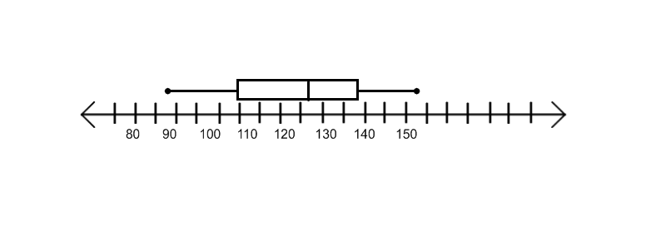
Create a box and whisker plot by plotting all 5 pieces of information. Then draw the plot.
Minimum = 88
Lower Quartile = 105
Median = 122
Upper Quartile = 133
Maximum = 148
-10
-9
-8
-7
-6
-5
-4
-3
-2
-1
0
1
2
3
4
5
6
7
8
9
10
80 90 100 110 120 130 140 150

Slide 110
46
Compare the two box and whisker plots.
Wrestling Team Weights
The interquartile range for last year's team was 15.
True
False
Notes:
Answer: False

Slide 111
47
Compare the two box and whisker plots.
Wrestling Team Weights
Both teams have about the same range.
True
False
Notes:
Answer: False

Slide 112
48
Compare the two box and whisker plots.
Wrestling Team Weights
Last year's quartiles and median are lower than this year's.
True
False
Notes:
Answer: False

Slide 113
49
Compare the two box and whisker plots.
Wrestling Team Weights
50% of the wrestlers weighed between 110 and 140 last year.
True
False
Notes:
Answer: True

Slide 114
Try this!
26 26 26 28 29 35 36 37 38 39
40 40 41 41 41 42 43 44 45 48
50 52 53 53 55 56 57 61 62 63
64 67 70 73
Minimum = _____
Lower Quartile = _____
Median = _____
Upper Quartile = _____
Maximum = _____
Notes:
Answer:
Minimum = 26
Lower Quartile = 38
Median = 43.5
Upper Quartile = 56
Maximum = 73

Slide 115
Try this!
107 115 116 129 132 134 140 142 142 144
145 148 149 152 153 154 154 154 154 155
Minimum = _____
Lower Quartile = _____
Median = _____
Upper Quartile = _____
Maximum = _____
Notes:
Answer:
Minimum = 107
Lower Quartile = 133
Median = 144.5
Upper Quartile = 153.5
Maximum = 155

Slide 116
Dot Plots
Return to
Table of
Contents

Slide 117
A dot plot (line plot) is a number line with marks that show the frequency of data. A dot plot helps you see where data cluster.
Example:
x
x
x
x
x
x
x
x
x
x
x
x
x
x
x
x
x
x
x
x
x
x
x
x
x
x
30
35
40
45
50
Test Scores
The count of "x" marks above each score represents the number of students who received that score.

Slide 118
x
x
x
x
x
x
x
x
x
x
x
x
x
x
x
x
x
x
x
x
x
x
x
x
x
x
30
35
40
45
50
Test Scores
Use the dot plot to answer the following questions.
How many students took the test?
What is the minimum score? Maximum?
What is the mean?
What is the mode?
What is the median (Q2)?
What is the lower quartile? Upper quartile?
Notes:
Answer:
26 students
Minimum = 30
Maximum = 50
Mean ≈ 40.1
Mode = 30
Median = 40
Lower Quartile = 35
Upper Quartile = 48

Slide 119
How to Make a Dot Plot
1. Organize the data. Use a list or frequency table.
2. Draw a number line with an appropriate scale.
3. Count the frequency of the first number and mark the
same amount of x's above that number on the line.
4. Repeat step 3 until you complete the data set.

Slide 120
1. Organize the data. Use a list or frequency table.
Miley is training for a bike-a-thon. The table shows the number of miles she biked each day. She has one day left in her training. How many miles is she most likely to bike on the last day?
Miles | Frequency
1 | 1
2 | 4
3 | 3
4 | 4
5 | 5
6 | 1
9 | 2
Distance Miley Biked (mi)
4 | 2 | 9 | 3 | 3
5 | 5 | 1 | 6 | 2
5 | 2 | 4 | 5 | 5
9 | 4 | 3 | 2 | 4

Slide 121
2. Draw a number line with an appropriate scale.
3. Count the frequency of the first number and mark the
same amount of x's above that number on the line.
4. Repeat step 3 until you complete the data set.
Click to reveal
1
2
3
4
5
6
7
8
9
10
How many miles is Miley most likely to bike on her last day?
Notes:
Teacher’s instructions: Use dual-screen mode to mark the x's on the number line.

Slide 122
Ms. Ruiz made a line plot to show the scores her students got on a test. Below is Ms. Ruiz's dot plot.
Use the dot plot to answer the next few questions.
Test Scores
x
x
x
x
x
x
x
x
x
x
x
x
x
x
x
x
x
x
x
x
x
x
x
x
x
x
x
x
x
75
80
85
90
95
100
Notes:
Teacher’s instructions: Use dual-screen mode and pin this screen to show the dot plot during responder questions.

Slide 123
50
What does each data item or "x" represent?
A
the teacher
B
a student
C
the test score
D
the entire class
Notes:
Answer: B

Slide 124
51
How many more students scored 75 than scored 85?
Notes:
Answer: 1

Slide 125
52
What is the median score?
Notes:
Answer: 85

Slide 126
53
What is the lower quartile of the test scores?
Notes:
Answer: 80

Slide 127
54
The upper quartile is 90.
True
False
Notes:
Answer: False. The upper quartile is 92.5.

Slide 128
55
What percent of the students scored an 80 or above on the test?
A
25%
B
50%
C
75%
D
100%
Notes:
Answer: C

Slide 129
56
What is the interquartile range of the test scores?
Notes:
Answer: 12.5

Slide 130
57
What is the mean of the test scores?
Notes:
Answer: 86.2

Slide 131
58
What are the mode(s) of the data set?
A
75
B
80
C
85
D
90
E
95
F
100
Notes:
Answer: A & D

Slide 132
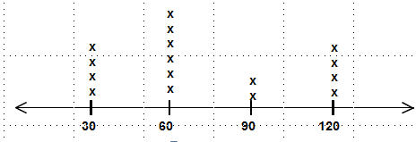
Try This!
Doug kept a record of how long he studied every night. Create a dot plot using the following data.
Doug's Study Times (minutes)
30 | 60 | 30 | 90
90 | 60 | 120 | 30
60 | 120 | 60 | 60
120 | 30 | 120 | 60
Click to reveal

Slide 133
Analyzing Data Displays
Return to
Table of
Contents

Slide 134
A data display shows us a lot of information about the measures of center and variability.
We can also determine a lot about the data that was collected by looking at a data display.
Let's look at the most recent test scores of some 6th grade students.
45 53 56 60 62 70 70 70 74 83
83 83 85 85 88 91 91 95 98 98
Find the:
Mean _____
Median _____
Mode _____
Range _____
Notes:
Answer:
Mean 77
Median 83
Mode 70 and 83
Range 53

Slide 135
Test Grades
8
6
4
2
0
Median
F
R
E
Q
U
E
N
C
Y
Mean
Notice that the histogram is not symmetrical. The data is pulled to the left because some students scored low.
30- 40- 50- 60- 70- 80- 90-
39 49 59 69 79 89 99
GRADE
The mean and median are not very close in this problem.
The mode is not the best choice to describe a data set because there can be more than one mode.
The range only tells us what the difference is but does not tell us how well most of the students performed on the test.

Slide 136
After the test, some students decided to re-take the test to improve their grade. The following are the new scores.
68 69 70 70 70 74 76 81 82 83
83 83 85 85 88 91 91 95 98 98
The new mean is 82 and very close to the median which is 83.
Test Grades
Mean & Median
Notice that the histogram is more symmetrical. The data is more symmetrically distributed because the scores are closer together.
F
R
E
Q
U
E
N
C
Y
8
6
4
2
0
30- 40- 50- 60- 70- 80- 90-
39 49 59 69 79 89 99
GRADE

Slide 137
Time Spent Doing Homework Last Night (Min)
0
5
10
15
20
25
30
35
40
45
50
The box and whisker plot above shows the number of minutes students spent doing homework last night.
The median is closer to the minimum than the maximum.
This means that 50% of the students that spent under 25 minutes on their homework probably spent a similar amount of time to each other.
On the other hand, the other half that studied more than the median time probably spent very different lengths of time on their homework.

Slide 138
Time Spent Doing Homework Last Night (Min)
0
5
10
15
20
25
30
35
40
45
50
Q1
Q3
The difference of the lower quartile and minimum is 5.
This shows us that 25% of the students shared a similar amount of studying time that was less than 20 minutes. The data is concentrated.
The difference of the maximum and upper quartile is 10.
This shows us that those students spent very different amounts of time so the "whisker" is longer even though it represents 25% of the class.

Slide 139
Students are asked to record the number of hours they volunteer doing community service per week.
Community Service
x
x
x
x
x
x
x
x
x
x
x
x
x
x
x
x
x
x
x
x
0
1
2
3
4
5
6
7
8
9
10
Number of Hours per Week
Find the:
Mean _____
Median _____
Mode _____
Range _____
Notes:
Answer:
Mean 3.9
Median 3
Mode 3
Range 9

Slide 140
Community Service
x
x
x
x
x
x
x
x
x
x
x
x
x
x
x
x
x
x
x
x
0
1
2
3
4
5
6
7
8
9
10
Number of Hours per Week
Does the dot plot look symmetrically distributed?
Why is the mean closer to 4 than to 3?
Notes:
Answer:
The dot plot is not symmetrically distributed.
Although much of the data is concentrated around the median it is pulled to the right because of the few students who volunteered many hours.
Therefore, the mean is greater than the median.

Slide 141
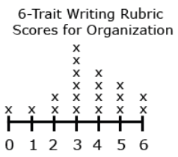
59
The median is greater than the mean. Explain your answer. (Determine by analyzing the graph instead of using a calculator.)
True
False
Notes:
Answer: False. The data is distributed towards the right and the median is 3.

Slide 142
Which measure of center appropriately represents the data?
60
A
Mean
B
Median
C
Mode
Paper Plane Competition
F
R
E
Q
U
E
N
C
Y
4
3
2
1
0
0-4 5-9 10-14 15-19 20-24
Distance (ft)
Notes:
Answer: B or C
The data is pulled towards the left making the median a more appropriate choice. There is only one mode and it is centered in the data making it a good representation of the data.

Slide 143
61
The number that is represented by the smallest interval on the histogram is called the ______________.
(Students type in their answers)
Paper Plane Competition
F
R
E
Q
U
E
N
C
Y
4
3
2
1
0
0-4 5-9 10-14 15-19 20-24
Distance (ft)
Notes:
Answer: Outlier

Slide 144
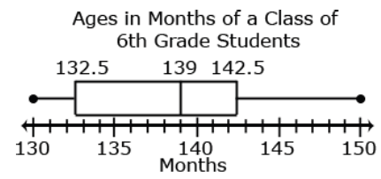
The students in the older half of the group are
62
A
very close in age
B
not so close in age
C
cannot be determined
Notes:
Answer: B
This is because the upper quartile is closer to the median so their ages vary more than the younger group.

Slide 145
63
In which interval are the students closest in age to each other?
A
130 - 132.5
B
132.5 - 139
C
139 - 142.5
D
142.5 - 150
Notes:
Answer: A
The students in this interval are the closest in age to each other because the interval is small.

